Slide 1

18CSC202J Object Oriented Design and Programming UNIT-1

Slide 2
18CSC202J - OBJECT ORIENTED DESIGN AND PROGRAMMING
Session 1
Topic : PROCEDURAL AND OBJECT ORIENTED PROGRAMMING

Slide 3
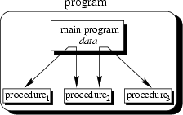
The main program coordinates calls to procedures and hands over appropriate data as parameters.

Slide 4
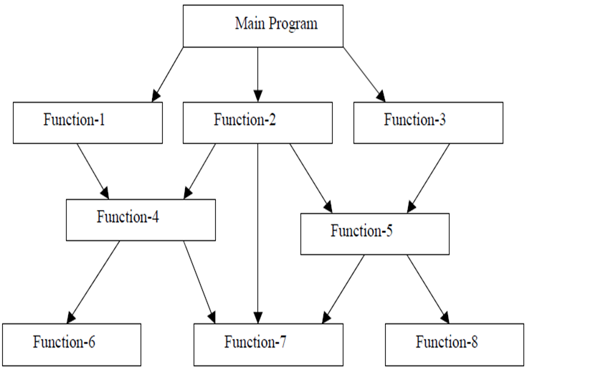
Procedure Oriented Programming Language

Slide 5
C function aspects | Syntax
Function declaration | Return-type function-name(argument list); Eg : int add(int a, int b);
Function definition | Return-type function-name(argument list) { body of function;) Eg : int add(int a, int b) {int c; c=a+b; Return c; }
Function call | Function-name(argument list); Eg : add(5,10);

Slide 6
Features of Procedure Oriented Programming Language
Smaller programs - A program in a procedural language is a list of instructions.
Larger programs are divided in to smaller programs known as functions.
Each function has a clearly defined purpose and a
clearly defined interface to the other functions in the program.
Data is Global and shared by almost all the functions.
Employs Top Down approach in Program Design.

Slide 7
Examples of Procedure Oriented Programming Language
COBOL
FORTRAN
C

Slide 8
Sample COBOL Program(Procedure Oriented)
IDENTIFICATION DIVISION.
PROGRAM-ID.
ENVIRONMENT DIVISION. * procedure will be followed by using few Division
DATA DIVISION.
WORKING-STORAGE SECTION.
77 A PIC 9999.
77 B PIC 9999.
77 ANS PIC 999V99.
PROCEDURE DIVISION.
MAIN-PARA.
DISPLAY \”--------------------------------\”.
DISPLAY \” ENTER A\”
ACCEPT A. * command line argument
DISPLAY \”ENTER B\”.
ACCEPT B.
DISPLAY \”----------------------------------\”.
ADD-PARA.
ADD A B GIVING ANS.
DISPLAY \”-------------------------------------\”.
DISP-PARA.
DISPLAY \”A IS \” A.
DISPLAY \”B IS \” B.
DISPLAY \”ADDITION -\” ANS.
STOP RUN. * to stop the program

Slide 9
Disadvantages of Procedural Programming Language
Unrestricted access
functions have unrestricted access to global data.
Real-world modeling
unrelated (separated) functions and data, the basis of the procedural paradigm, provide a poor model of the real world.
Complex real-world objects have both attributes (data) and behavior (function).

Slide 10
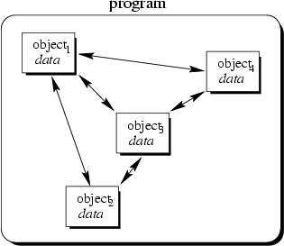
Object-Oriented Concept
Objects of the program interact by sending messages to each other, hence it increases the data security (data can be accessed only through its instances)

Slide 11
Object Oriented Programming
Object-oriented programming is a programming paradigm that uses abstraction in the form of classes and objects to create models based on the real world environment.
An object-oriented application uses a collection of objects, which communicate by passing messages to request services.
The aim of object-oriented programming is to try to increase the flexibility and maintainability of programs.
Because programs created using an OO language are modular, they can be easier to develop, and simpler to understand after development

Slide 12
Object-Oriented Concepts
Everything is an object and each object has its own memory
Computation is performed by objects communicating with each other
Every object is an instance of a class. A class simply represents a grouping of similar objects, such as Integers or lists.
The class is the repository for behavior associated with an object. That is, that all objects that are instances of the same class can perform the same actions.
Classes are organized into a singly rooted tree structure, called the inheritance hierarchy.
Memory and behavior associated with instances of a class are automatically available to any class associated with a descendant in this tree structure.

Slide 13
Object-Oriented Programming vs. Procedural Programming
Programs are made up of modules, which are parts of a program that can be coded and tested separately, and then assembled to form a complete program.
In procedural languages (i.e. C) these modules are procedures, where a procedure is a sequence of statements.
The design method used in procedural programming is called Top Down Design.
This is where you start with a problem (procedure) and then systematically break the problem down into sub problems (sub procedures).

Slide 14
Object-Oriented Programming vs. Procedural Programming
The difficulties with Procedural Programming, is that software maintenance can be difficult and time consuming.
When changes are made to the main procedure (top), those changes can cascade to the sub procedures of main, and the sub-sub procedures and so on, where the change may impact all procedures in the pyramid.
Object oriented programming is meant to address the difficulties with procedural programming.

Slide 15
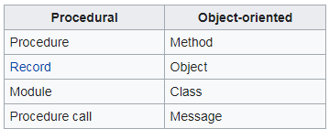
The main difference

Slide 16
Comparison
Procedural Oriented Object Oriented
Program is divided into small parts called ‘Functions’
Program is divided into small parts called ‘Objects’
Global and Local data
Has access specifiers : Public, Private, Protected
Doesn’t have any proper way for hiding data
Provides data hiding and security
Eg: C, VB, FORTAN Eg: C++, JAVA, VB.NET

Slide 17
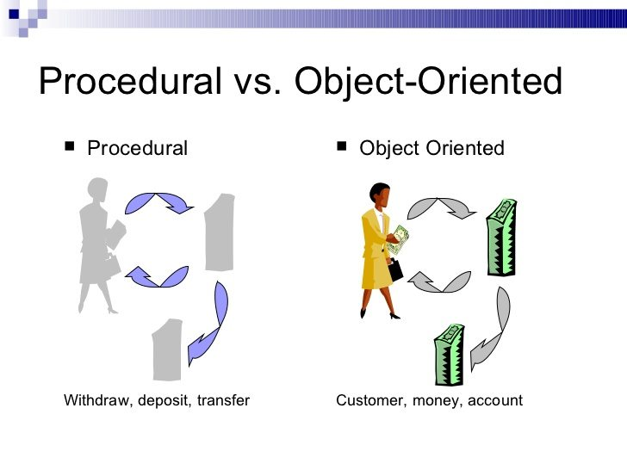
Comparison

Slide 18
Session-2

Slide 19
Topics covered
I/O Operation
Data types
Variable
Static
Constant
Pointer
Type conversion

Slide 20
I/O Operation
C++ I/O operation occurs in streams, which involve transfer of information into byte
It’s a sequences of bytes
Stream involved in two ways
It is the source as well as the destination of data
C++ programs input data and output data from a stream.
Streams are related with a physical device such as the monitor or with a file stored on the secondary memory.
In a text stream, the sequence of characters is divided into lines, with each line being terminated.
With a new-line character (\n) . On the other hand, a binary stream contains data values using their memory representation.

Slide 21
Stream in C
Text Stream
Binary Stream

Slide 22
Cascading of Input or Output Operators
<< operator –It can use multiple times in the same line.
Its called Cascading
Cout ,Cin can cascaded
For example
cout<<“\n Enter the Marks”;
cin>> ComputerNetworks>>OODP;

Slide 23
Reading and Writing Characters and Strings
char marks;
cin.get(marks);//The value for marks is read
OR
marks=cin.get();//A character is read and assigned to marks
string name;
Cin>>name;
string empname;
cin.getline(empname,20);
Cout<<“\n Welcome ,”<<empname;

Slide 24
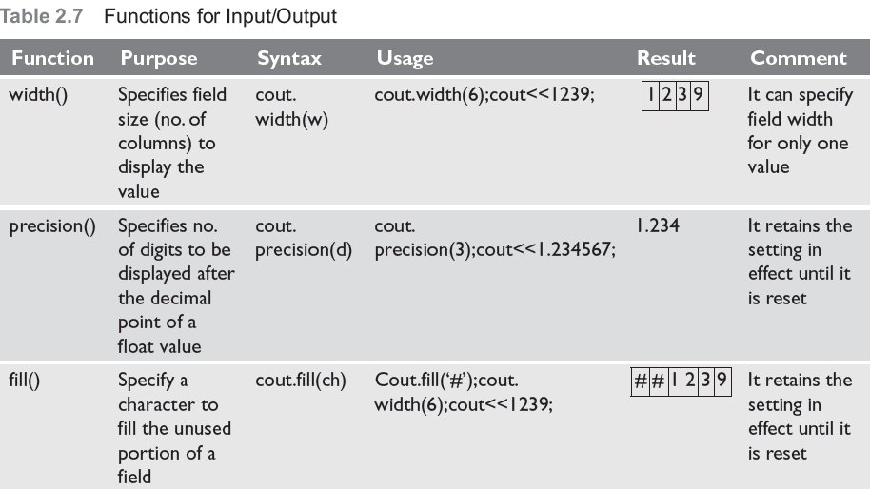
Formatted Input and Output Operations
Formatted I/O
I/O class function and flages
Manipulators
#include<iostream.h>
#define PI 3.14159
main()
{
cout.precision(3);
cout.width(10);
cout.fill(‘*’);
cout<<PI;
Output
*****3.142

Slide 25
Formatting with flags
The setf() is a member function of the ios class that is used to set flags for formatting output.
syntax -cout.setf(flag, bit-field)
Here, flag defined in the ios class specifies how the output should be formatted
bit-field is a constant (defined in ios ) that identifies the group to which the formatting flag belongs to.
There are two types of setf()—one that takes both flag and bit-fields and the other that takes only the flag .

Slide 26
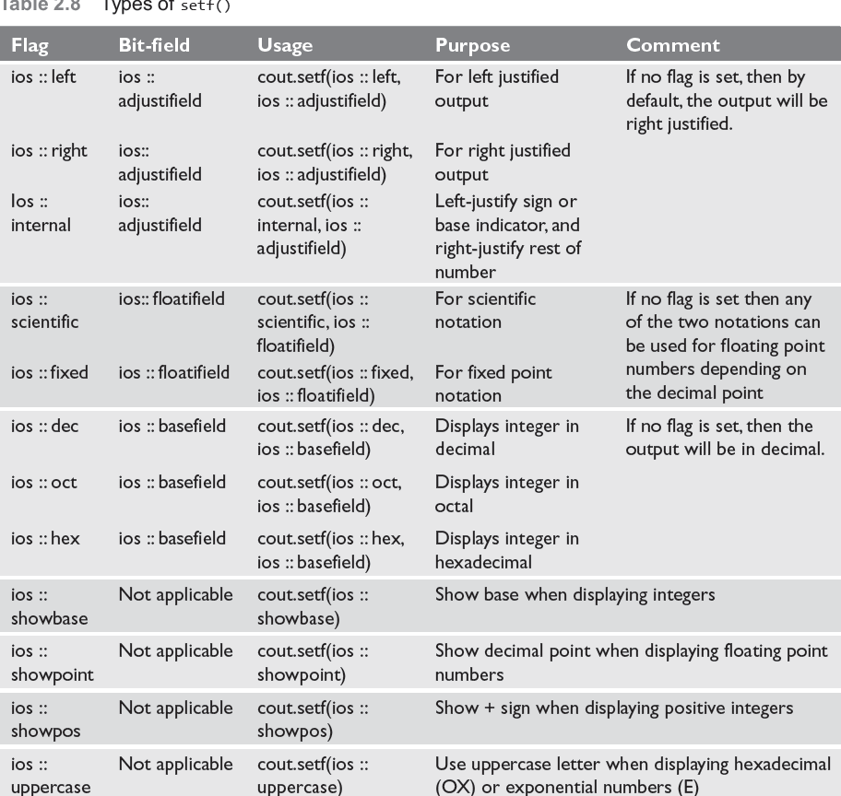

Slide 27
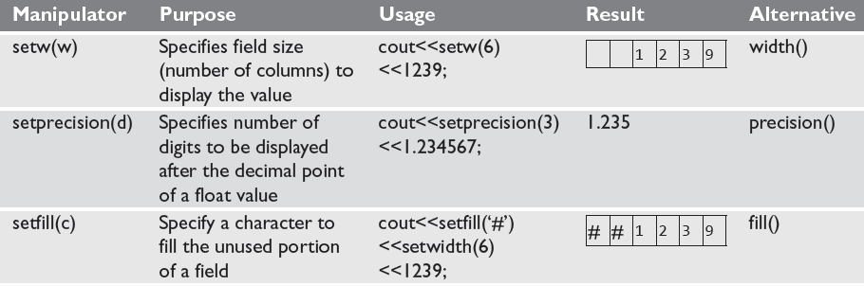
Formatting Output Using Manipulators
C++ has a header file iomanip.h that contains certain manipulators to format the output

Slide 28
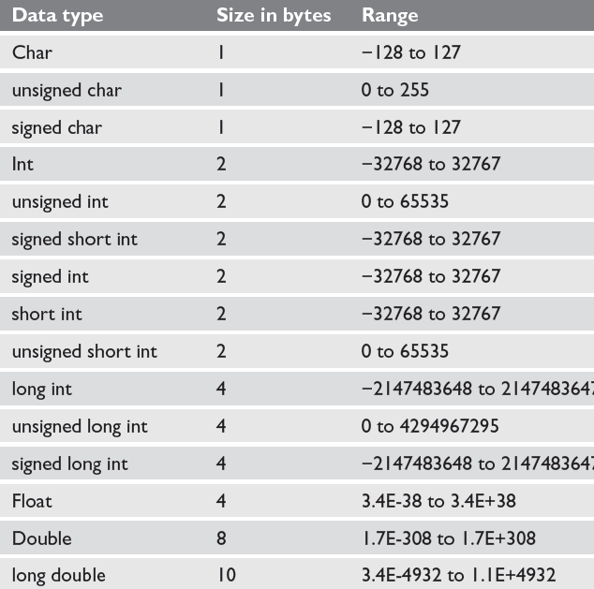
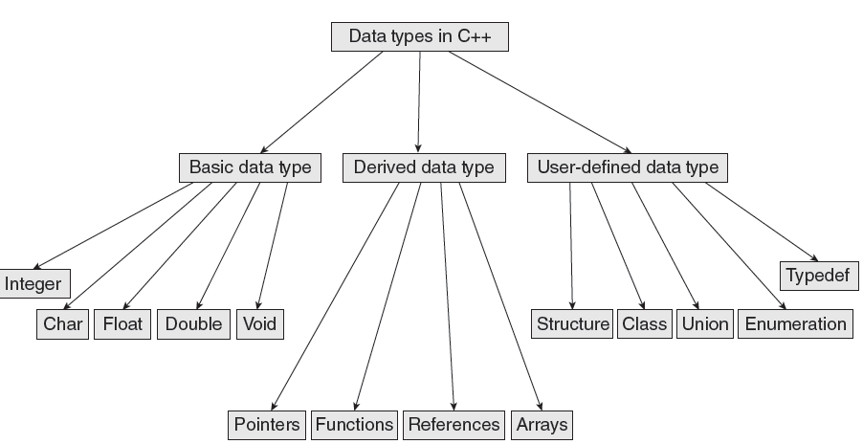
Data Types in C++

Slide 29

Variables
A variable is the content of a memory location that stores a certain value. A variable is identified or denoted by a variable name. The variable name is a sequence of one or more letters, digits or underscore, for example: character_
Rules for defining variable name:
A variable name can have one or more letters or digits or underscore for example character_.
White space, punctuation symbols or other characters are not permitted to denote variable name.
A variable name must begin with a letter.
Variable names cannot be keywords or any reserved words of the C++ programming language.
Data C++ is a case-sensitive language. Variable names written in capital letters differ from variable names with the same name but written in small letters.
01
Local Variables
03
Instance variables
02
Static Variables
04
Final Variables

Slide 30
Variables
Local Variables
Instance Variables
Static Variables
Constant Variables
Local variable: These are the variables which are declared within the method of a class.
Example:
public class Car {
public:
void display(int m){ // Method
int model=m; // Created a local variable model
cout<<model;
}
Instance variable: These are the variables which are declared in a class but outside a method, constructor or any block.
Example:
public class Car {
private: String color;
// Created an instance variable color
Car(String c)
{
color=c;
}}
Static variables: Static variables are also called as class variables. These variables have only one copy that is shared by all the different objects in a class.
Example:
public class Car {
public static int tyres;
// Created a class variable void init(){
tyres=4;
} }
Constant is something that doesn't change. In C language and C++ we use the keyword const to make program elements constant.
Example:
const int i = 10;
void f(const int i)
class Test
{
const int i;
};

Slide 31
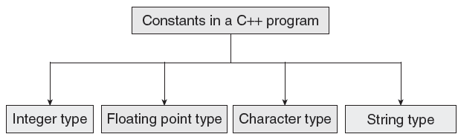
CONSTANTS
Constants are identifiers whose value does not change. While variables can change their value at any time, constants can never change their value.
Constants are used to define fixed values such as Pi or the charge on an electron so that their value does not get changed in the program even by mistake.
A constant is an explicit data value specified by the programmer.
The value of the constant is known to the compiler at the compile time.

Slide 32
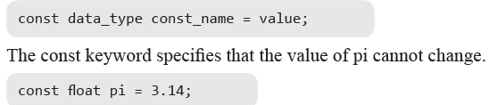
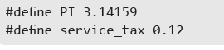
Declaring Constants
Rule 1 Constant names are usually written in capital letters to visually distinguish them from other variable names which are normally written in lower case characters.
Rule 2 No blank spaces are permitted in between the # symbol and define keyword.
Rule 3 Blank space must be used between #define and constant name and between constant name and constant value.
Rule 4 #define is a preprocessor compiler directive and not a statement. Therefore, it does not end with a semi-colon.

Slide 33
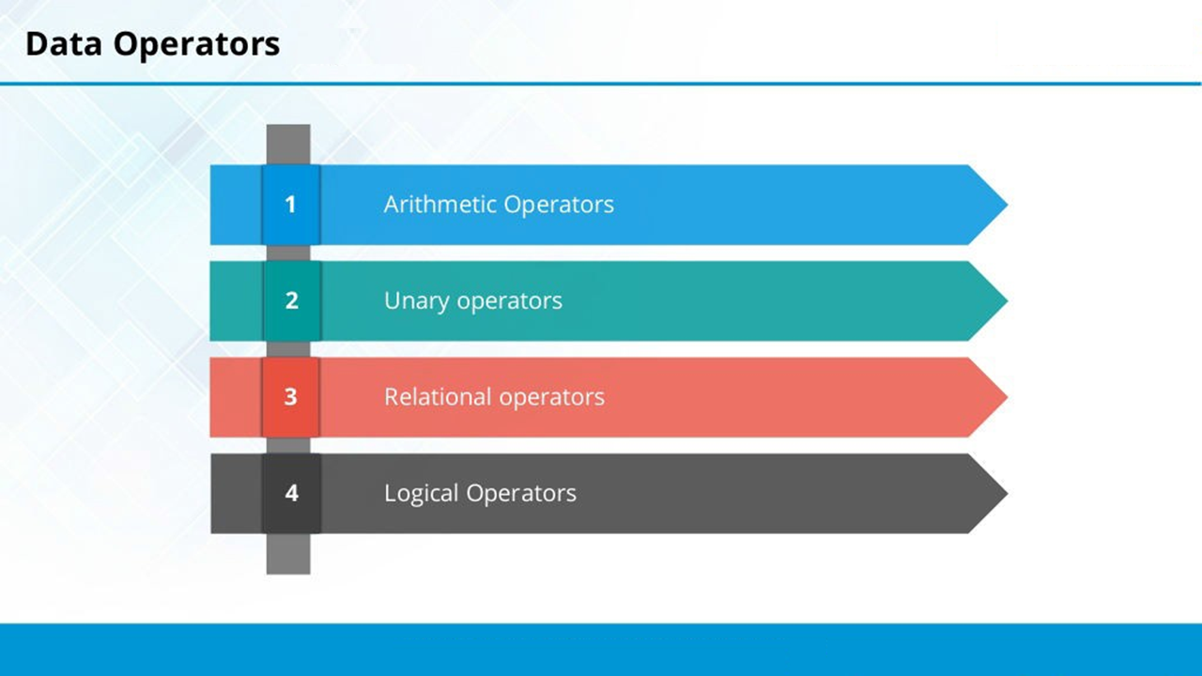

Slide 34
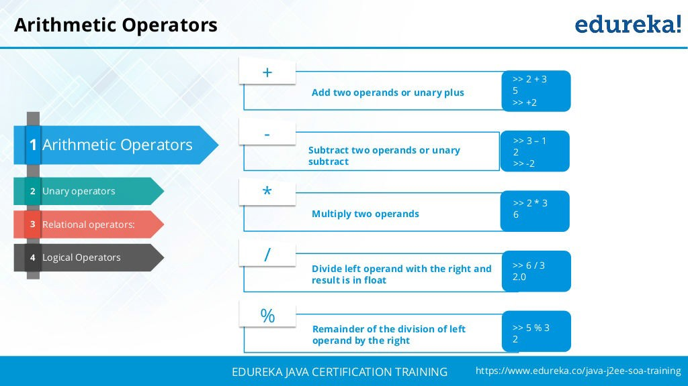

Slide 35
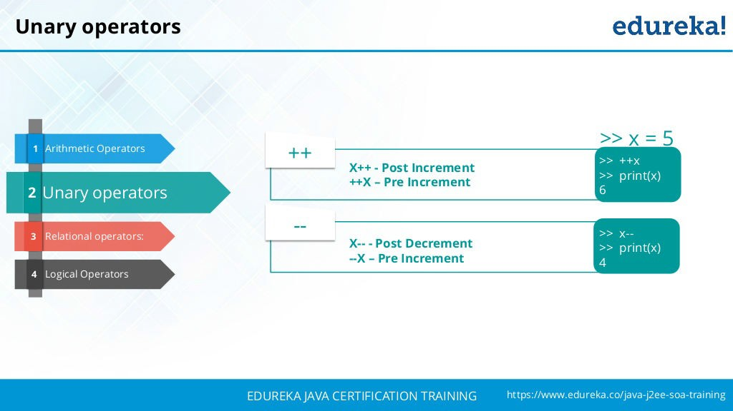

Slide 36
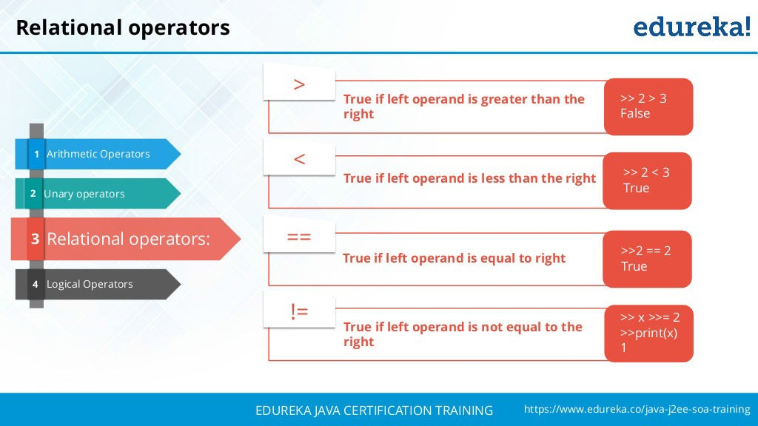

Slide 37
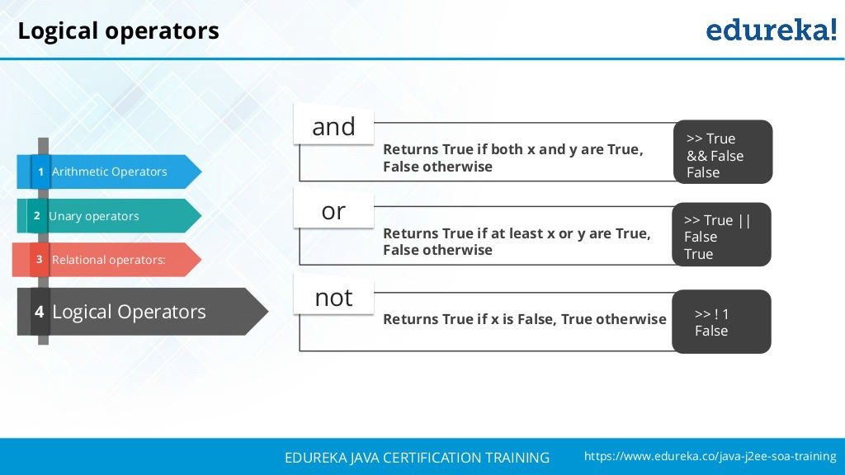

Slide 38

Special Operators
Scope resolution operator
In C, the global version of a variable cannot be accessed from within the inner block. C++ resolves this problem by using scope resolution operator (::), because this operator allows access to the global version of a variable.
1
New Operator
2
The new operator denotes a request for memory allocation on the Heap. If sufficient memory is available, new operator initializes the memory and returns the address of the newly allocated and initialized memory to the pointer variable.
Delete Operator
3
Since it is programmer’s responsibility to deallocate dynamically allocated memory, programmers are provided delete operator by C++ language.
Member Operator
4
C++ permits us to define a class containing various types of data & functions as members. To access a member using a pointer in the object & a pointer to the member.

Slide 39
Operator Precedence
Rank | Operators | Associativity
1 | ++, --, +, -, !(logical complement) ,~(bitwise complement) ,(cast) | Right
2 | *(mul) , /(div), %(mod) | Left
3 | + , - (Binary) | Left
4 | >> , <<, >>> (Shift operator) | Left
5 | >, <, >=,<= | Left
6 | ==, != | Left
7 | & (Bitwise and) | Left
8 | ^ ( XOR) | Left
9 | | (Bitwise OR) | Left
10 | && (Logical and) | Left
11 | || (Logical OR) | Left
12 | Conditional | Right
13 | Shorthand Assignment | Right

Slide 40
Pointers

Slide 41
Introduction
Pointers are symbolic representation of addresses.
They enable programs to simulate call-by-reference as well as to create and manipulate dynamic data structures.
Syntax data_type *pointer_variable;
Example
int *p,sum;
Assignment
integer type pointer can hold the address of another int variable
To assign the address of variable to pointer-ampersand symbol (&)
p=&sum;
this pointer
hold the adderss of current object
int num;
This->num=num;
Void?
When used in the declaration of a pointer, void specifies that the pointer is "universal." If a pointer's type is void* , the pointer can point to any variable that's not declared with the const or volatile keyword.

Slide 42
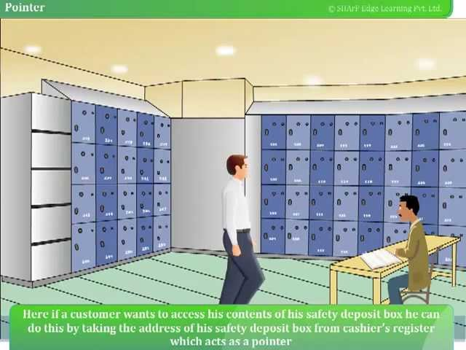
Real Time Example

Slide 43
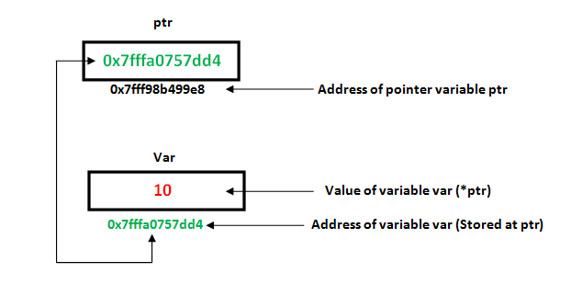
How to use it
P=&sum;//assign address of another variable
cout<<&sum; //to print the address of variable
cout<<p;//print the value of variable
Example of pointer
#include<iostream.h>
using namespace std;
int main()
{ int *p,sum=10;
p=&sum;
cout<<“Address of sum:”<<&sum<<endl;
cout<<“Address of sum:”<<p<<endl;
cou<<“Address of p:”<<&p<<endl;
cout<<“Value of sum”<<*p;
}
Output:
Address of sum : 0X77712
Address of sum: 0x77712
Address of p: 0x77717
Value of sum: 10

Slide 44
Pointers and Arrays
assigning the address of array to pointer don’t use ampersand sign(&)
#include <iostream>
using namespace std;
int main(){
//Pointer declaration
int *p;
//Array declaration
int arr[]={1, 2, 3, 4, 5, 6};
//Assignment
p = arr;
for(int i=0; i<6;i++){
cout<<*p<<endl;
//++ moves the pointer to next int position
p++;
}
return 0;
}
OUTPUT:
0
1
2
3
4
5
6

Slide 45
This Pointers
this pointer hold the address of current object
int num;
This->num=num;

Slide 46
This pointer Example
101 Sonoo 890000 102 Nakul 59000
101 Sonoo 890000 102 Nakul 59000
101 Sonoo 890000 102 Nakul 59000
101 Sonoo 890000
#include <iostream>
using namespace std;
class Employee {
public:
int id; //data member (also instance variable)
string name; //data member(also instance variable)
float salary;
Employee(int id, string name, float salary) Output: 101 Sonoo 890000
{
this->id = id; 102 Nakul 59000
this->name = name;
this->salary = salary;
}
void display() {
cout<<id<<" "<<name<<" "<<salary<<endl;
} };
int main(void) {
Employee e1 =Employee(101, "Sonoo", 890000); //creating an object of Employee
Employee e2=Employee(102, "Nakul", 59000); //creating an object of Employee
e1.display(); e2.display(); return 0; }

Slide 47
Function using pointers
#include<iostream>
using namespace std;
void swap(int *a ,int *b );
//Call By Reference
int main()
{
int p,q;
cout<<"\nEnter Two Number You Want To Swap \n";
cin>>p>>q;
swap(&p,&q);
cout<<"\nAfter Swapping Numbers Are Given below\n\n";
cout<<p<<" "<<q<<" \n";
return 0;
}
void swap(int *a,int *b)
{
int c;
c=*a;
*a=*b;
*b=c;
}
Output:
Enter Two Number You Want to Swap
10 20
After Swapping Numbers Are Given below
20 10

Slide 48
MCQ
What will happen in the following C++ code snippet?
1)Int a=100, b=200;
2) Int *p=&a, *q=&b;
3) p=q;
Choose the correct one.
a) b is assigned to a b) p now points to b c) a is assigned to b d) q now points to a

Slide 49
MCQ - Answer
a) b is assigned to a b) p now points to b c) a is assigned to b d) q now points to a

Slide 50
MCQ-What is output of the following code?
#include <iostream>
using namespace std;
int main()
{
char arr[20];
int i;
for(i = 0; i < 10; i++)
*(arr + i) = 65 + i;
*(arr + i) = '\0';
cout << arr;
return(0);
}

Slide 51
MCQ - Answer
Answer: ABCDEFGHIJ Explanation: Each time we are assigning 65 + i.
In first iteration i = 0 and 65 is assigned.
So it will print from A to J.

Slide 52
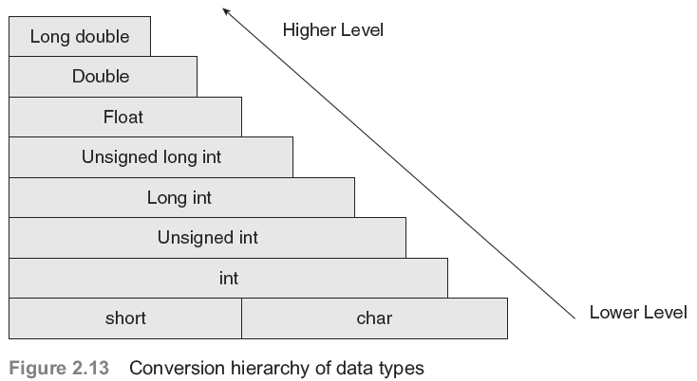
Type conversion and type casting
Type conversion or typecasting of variables refers to changing a variable of one data type into another.
While type conversion is done implicitly, casting has to be done explicitly by the programmer.

Slide 53
Implicit Type Conversion
The type conversion that is done automatically done by the compiler is known as implicit type conversion. This type of conversion is also known as automatic conversion.
#include <iostream>
using namespace std;
int main()
{
int x = 10;
// integer x
char y = 'a’;
// character y implicitly converted to int. ASCII
// value of 'a' is 97
x = x + y;
// x is implicitly converted to float
int z = x + 1;
cout << "x = " << x << endl<< "y = " << y << endl<< "z = " << z << endl;
return 0;}
Output:
x = 107
y = a
z = 108

Slide 54
Type Casting
Type casting an arithmetic expression tells the compiler to represent the value of the expression in a certain format.
It is done when the value of a higher data type has to be converted into the value of a lower data type.
However, this cast is under the programmer’s control and not under the compiler’s control.
Syntax:
destination_variable_name=destination_data_type(source_variable_name);
float sal=10000.00;
int income;
Income=int(sal);

Slide 55
Example for Explicit Type Conversion
#include <iostream>
using namespace std;
int main()
{ double x = 1.2;
// Explicit conversion from double to int
int sum = (int)x + 1;
cout << "Sum = " << sum;
return 0;}
Output:
Sum = 2

Slide 56
Session-3
Class and objects - Features

Slide 57
Class
Class is a user defined data type, defined using keywork class.
It holds its own data members and member functions,
It can be accessed and used by creating instance of that class.
The variables inside class definition are called as data members and
the functions are called member functions
class className
{
data members
member functions
};

Slide 58
Class is just a blue print, which declares and defines characteristics and behavior, namely data members and member functions respectively.
All objects of this class will share these characteristics and behavior.
Class name must start with an uppercase letter(Although this is not mandatory).
Example,
class Student
Example
class Room {
public:
double length;
double breadth;
double height;
double calculateArea(){
return length * breadth;
}
double calculateVolume(){
return length * breadth * height;
}
};

Slide 59
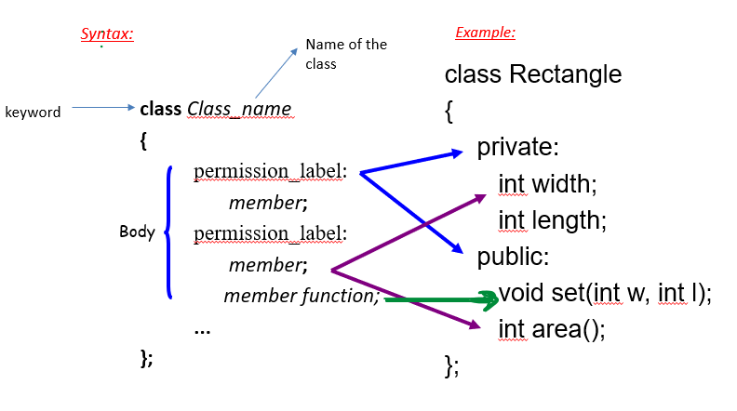
Define a Class Type

Slide 60
- Data members Can be of any type, built-in or user-defined.
This may be,
non-static data member
Each class object has its own copy
static data member
Acts as a global variable

Slide 61
Static data member is declared using the static keyword.
There is only one copy of the static data member in the class. All the objects share the static data member.
The static data member is always initialized to zero when the first class object is created.
Syntax:
static data_type datamember_name;
Here
static is the keyword.
data_type – int , float etc…
datamember_name – user defined

Slide 62
Static Data Member
class Rectangle
{
private:
int width;
int length;
static int count;
public:
void set(int w, int l);
int area();
}
Rectangle r1;
Rectangle r2;
Rectangle r3;
count
r1
r2
width
length
width
length
width
length
r3

Slide 63
Member Functions
Used to
access the values of the data members (accessor)
perform operations on the data members (implementor)
Are declared inside the class body
Their definition can be placed inside the class body, or outside the class body
Can access both public and private members of the class
Can be referred to using dot or arrow member access operator

Slide 64
Member function
keyword
Class Name
class Rectangle
{
private:
int width, length;
public:
void set (int w, int l);
int area()
{
return width*length;
}
}r1,;
void Rectangle :: set (int w, int l)
{
width = w;
length = l;
}
int main()
{
Rectangle r2;
r1.set(5,8);
int x=r1.area();
cout<<"x value in r1 "<<x;
r2.set(5,8);
int x=r1.area();
cout<<"x value in r2 "<<x;
}
Object creation
Inside the function
member function
inside the class
class name
Member function
Object
creation
outside the class
scope operator

Slide 65
const member function
The const member functions are the functions which are declared as constant in the program.
The object called by these functions cannot be modified.
It is recommended to use const keyword so that accidental changes to object are avoided.
A const member function can be called by any type of object.
Note: Non-const functions can be called by non-const objects only.
Syntax:
datatype function_name const();
User defined
keyword

Slide 66
Const Member Function
class Time
{
private :
int hrs, mins, secs ;
public :
void Write ( ) const ;
} ;
function declaration
function definition
void Time :: Write( ) const
{
cout <<hrs << “:” << mins << “:” << secs << endl;
}

Slide 67
What is an object?
OBJECT
set of methods
(member functions)
internal state
(values of private data members)
Operations
Data

Slide 68
Object:
Objects are instances of class, which holds the data variables declared in
class and the member functions work on these class objects.
Each object has different data variables.
Objects are initialized using special class functions called Constructors.
Destructor is special class member function, to release the memory reserved
by the object.
Syntax of creating object :
Class_name object_name;

Slide 69
Declaration of an Object
class Rectangle
{
private:
int width;
int length;
public:
void set(int w, int l);
int area();
};
main()
{
Rectangle r1;
Rectangle r2;
r1.set(5, 8);
cout<<r1.area()<<endl;
r2.set(8,10);
cout<<r2.area()<<endl;
}

Slide 70
Another Example
#include <iostream.h>
class circle
{
private:
double radius;
public:
void store(double);
double area(void);
void display(void);
};
// member function definitions
void circle::store(double r)
{
radius = r;
}
double circle::area(void)
{
return 3.14*radius*radius;
}
void circle::display(void)
{
cout << “r = “ << radius << endl;
}
int main(void) {
circle c; // an object of circle class
c.store(5.0);
cout << "The area of circle c is " << c.area() << endl;
c.display();
}

Slide 71
Declaration of an Object
class Rectangle
{
private:
int width;
int length;
public:
void set(int w, int l);
int area();
};
r1 is statically allocated
main()
{
Rectangle r1;
r1.set(5, 8);
}
r1
width
length
width = 5
length = 8

Slide 72
Declaration of an Object
class Rectangle
{
private:
int width;
int length;
public:
void set(int w, int l);
int area();
};
r2 is a pointer to a Rectangle object
main()
{
Rectangle r1;
r1.set(5, 8);
Rectangle *r2;
r2 = &r1;
r2->set(8,10);
}
//dot notation
//arrow notation
5000
r1
width = 8
length = 10
r2
6000
width
length
width = 5
length = 8
???
5000

Slide 73
Object Initialization
1. By Assignment
#include <iostream.h>
class circle
{
public:
double radius;
};
Only work for public data
members
No control over the operations
on data members
int main()
{
circle c1; // Declare an instance of the class circle
c1.radius = 5; // Initialize by assignment
}

Slide 74
Object Initialization
2. By Public Member Functions
#include <iostream.h>
class circle
{
private:
double radius;
public:
void set (double r)
{radius = r;}
double get_r ()
{return radius;}
};
int main(void) {
circle c; // an object of circle class
c.set(5.0); // initialize an object with a public member function
cout << "The radius of circle c is " << c.get_r() << endl;
// access a private data member with an accessor
}

Slide 75
Declaration & Initialization of an Object
#include <iostream.h>
class circle
{
public:
double radius;
};
Only work for public data
members
No control over the operations
on data members
int main()
{
circle c1; // Declare an instance of the class circle
c1.radius = 5; // Initialize by assignment
}

Slide 76
Examples
class Rectangle
{
private:
int width;
int length;
public:
void set(int w, int l);
int area();
};
main()
{
Rectangle r1;
Rectangle r2;
r1.set(5, 8);
cout<<r1.area()<<endl;
r2.set(8,10);
cout<<r2.area()<<endl;
}

Slide 77
Example: 2
// Program to illustrate the working of
// objects and class in C++ Programming
#include <iostream>
using namespace std;
// create a class
class Room {
public:
double length;
double breadth;
double height;
double calculateArea() {
return length * breadth;
}
double calculateVolume() {
return length * breadth * height;
}
};
int main() {
// create object of Room class
Room room1;
// assign values to data members
room1.length = 42.5;
room1.breadth = 30.8;
room1.height = 19.2;
// calculate and display the area and volume of the room
cout << "Area of Room = " << room1.calculateArea() << endl;
cout << "Volume of Room = " << room1.calculateVolume() << endl;
return 0;
}

Slide 78
Sample Exercises
Find whether the student is eligible for the current year placement from the inputs student name, CGPA, gender (M/F), number of backlogs. Implement the above by using object oriented programming concept.
2)Employee payroll system contains the fileds Employee name,Employee ID,Basic pay,HRA,TA,,DA,Grade pay and Deduction 5% from Basic pay.Find the Gross pay, Net pay (Grade pay + deductions) and print all the details given above, using class and object of get () method and cal( )method.
3)Write a program that would print the information (name, year of joining, salary, address) of three employees by creating a class named &#39;Employee&#39;. The output should be as follows:
Name Year of joining Address
Robert 1994 64C- WallsStreat
Sam 2000 68D- WallsStreat
John 1999 26B- WallsStreat

Slide 79
Session-4 Feature : Objects and Classes

Slide 80
Objects and Classes
Class is a user defined data type, which holds its own data members and member functions, which can be accessed and used by creating instance of that class.
Attributes – member of a class.
An attribute is the data defined in a class that maintains the current state of an object. The state of an object is determined by the current contents of all the attributes.
Methods – member functions of a class

Slide 81
Objects and classes
A class itself does not exist; it is merely a description of an object.
A class can be considered a template for the creation of object
Blueprint of a building 🡪 class
Building 🡪 object
An object exists and is definable.
An object exhibits behavior, maintains state, and has traits. An object can be manipulated.
An object is an instance of a class.

Slide 82
Methods
A method is a function that is part of the class definition. The methods of a class specify how its objects will respond to any particular message.
A method is a collection of statements that perform some specific task and return the result to the caller. A method can perform some specific task without returning anything.
Methods allow us to reuse the code without retyping the code.
A message is a request, sent to an object, that activates a method (i.e., a member function).

Slide 83
Defining a Base Class - Example
A base class is not defined on, nor does it inherit members from, any other class.
#include <iostream>
using std::cout; //this example “uses” only the necessary
using std::endl; // objects, not the entire std namespace
class Fraction {
public:
void assign (int, int); //member functions
double convert();
void invert();
void print();
private:
int num, den; //member data
};
Continued…

Slide 84
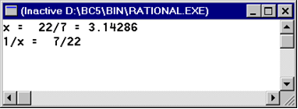
Using objects of a Class - Example
The main() function:
int main()
{
Fraction x;
x.assign (22, 7);
cout << "x = "; x.print();
cout << " = " << x.convert() << endl;
x.invert();
cout << "1/x = "; x.print(); cout << endl;
return 0;
}
Continued…

Slide 85
Defining a Class – Example
Class Implementation:
void Fraction::assign (int numerator, int denominator)
{
num = numerator;
den = denominator;
}
double Fraction::convert ()
{
return double (num)/(den);
}
void Fraction::invert()
{
int temp = num;
num = den;
den = temp;
}
void Fraction::print()
{
cout << num << '/' <
}< den;

Slide 86
Difference Between Class and Structure
S.No | Class | Structure
1 | Members of a class are private by default. | Members of a structure are public by default.
2 | Member classes/structures of a class are private by default. | Member classes/structures of a structure are public by default.
3 | It is normally used for data abstraction and further inheritance. | It is normally used for the grouping of data
4 | Security is high here. | Less Security.
5 | It is declared using the class keyword. | It is declared using the struct keyword.

Slide 87
Debug the code
/*Beginning of structDistance02.cpp*/
#include <iostream.h>
struct Distance {
private: int iFeet; float fInches;
public: void setFeet(int x) {
iFeet=x; //????? Legal or not
int getFeet()
{ return iFeet; }
void setInches(float y) {
fInches=y; }
float getInches() {
return fInches; } };

Slide 88
Debug the code
void main() {
Distance d1,d2;
d1.setFeet(2);
d1.setInches(2.2);
d2.setFeet(3);
d2.setInches(3.3);
d1.iFeet++; // ??????
cout<<d1.getFeet()<<d1.getInches()<<d2.getFeet()<<d2.getInches()<<endl;

Slide 89
Scope Resolution Operator
It is possible and usually necessary for the library programmer to define the member functions outside their respective classes.
The scope resolution operator makes this possible.
Program illustrates the use of the scope resolution operator (::)

Slide 90
Scope Resolution Operator Example
/*Beginning of scopeResolution.cpp*/
class Distance
{
int iFeet;
float fInches;
public:
void setFeet(int); //prototype only
int getFeet(); //prototype only
void setInches(float); //prototype only
float getInches(); //prototype only
};
void Distance::setFeet(int x) //definition { iFeet=x; }
int Distance::getFeet() //definition { return iFeet; }
void Distance::setInches(float y) //definition { fInches=y; }
float Distance::getInches() //definition{return fInches;}
/*End of scopeResolution.cpp*/

Slide 91
Session 3 ,7 Topic : UML Class Diagram, its components, Class Diagram relations and Multiplicity

Slide 92
A Recap……
void Fraction::assign (int numerator, int denominator)
{
num = numerator;
den = denominator;
}
double Fraction::convert ()
{
return double (num)/(den);
}
void Fraction::invert()
{
int temp = num;
num = den;
den = temp;
}
void Fraction::print()
{
cout << num << '/' << den;
}
#include <iostream>
using namespace std;
class Fraction {
public:
void assign (int, int);
double convert();
void invert();
void print();
private:
int num, den;
};
int main()
{
Fraction x;
x.assign (22, 7);
cout << "x = "; x.print();
cout << " = " << x.convert() << endl;
x.invert();
cout << "1/x = "; x.print(); cout << endl;
return 0;
}

Slide 93
UML Diagrams - Introduction
UML stands for Unified Modeling Language
It is a modern approach to modeling and documenting software
It is one of the most popular business process modeling techniques
It is based on diagrammatic representations of software components
An old proverb says, “A picture is worth a thousand words”
By using visual representations, we are able to better understand possible flaws or errors in software or business processes

Slide 94
UML Diagrams - Introduction
SKETCH
In this case, UML diagrams are only a top-level view of the system
It may not include all the necessary details to execute the project
Forward Design:
The design of the sketch is done before coding the application
We can get a better view of the system or workflow that we are trying to create
Many design issues or flaws can be revealed
The overall project health and well-being can be improved
Backward Design:
After writing the code, the UML diagrams are drawn as a form of documentation

Slide 95
UML Diagrams - Introduction
BLUEPRINT
In this case, the UML diagram serves as a complete design that requires the actual implementation of the system or software.
Often, this is done by using CASE tools (Computer Aided Software Engineering Tools)
It needs more expertise and user training

Slide 96
What is a use case diagram?
In the Unified Modeling Language (UML), a use case diagram can summarize the details of your system's users (also known as actors) and their interactions with the system. To build one, you'll use a set of specialized symbols and connectors. An effective use case diagram can help your team discuss and represent:
Scenarios in which your system or application interacts with people, organizations, or external systems
Goals that your system or application helps those entities (known as actors) achieve
The scope of your system

Slide 97
Use case diagram components
Actors: The users that interact with a system. An actor can be a person, an organization, or an outside system that interacts with your application or system. They must be external objects that produce or consume data.
System: A specific sequence of actions and interactions between actors and the system. A system may also be referred to as a scenario.
Goals: The end result of most use cases. A successful diagram should describe the activities and variants used to reach the goal.

Slide 98
Use case diagram symbols and notation
Use cases: Horizontally shaped ovals that represent the different uses that a user might have.
Actors: Stick figures that represent the people actually employing the use cases.
Associations: A line between actors and use cases. In complex diagrams, it is important to know which actors are associated with which use cases.
System boundary boxes: A box that sets a system scope to use cases. All use cases outside the box would be considered outside the scope of that system.
For example, Psycho Killer is outside the scope of occupations in the chainsaw example found
below.
Packages: A UML shape that allows you to put different elements into groups. Just as with component diagrams, these groupings are represented as file folders.

Slide 99
The following topics describe the relationships that you can use in use-case diagrams:
Association relationships In UML models, an association is a relationship between two classifiers, such as classes or use cases, that describes the reasons for the relationship and the rules that govern the relationship.
Generalization relationships In UML modeling, a generalization relationship is a relationship in which one model element (the child) is based on another model element (the parent). Generalization relationships are used in class, component, deployment, and use-case diagrams to indicate that the child receives all of the attributes, operations, and relationships that are defined in the parent.
Include relationships In UML modeling, an include relationship is a relationship in which one use case (the base use case) includes the functionality of another use case (the inclusion use case). The include relationship supports the reuse of functionality in a use-case model.
Extend relationships In UML modeling, you can use an extend relationship to specify that one use case (extension) extends the behavior of another use case (base). This type of relationship reveals details about a system or application that are typically hidden in a use case.

Slide 100
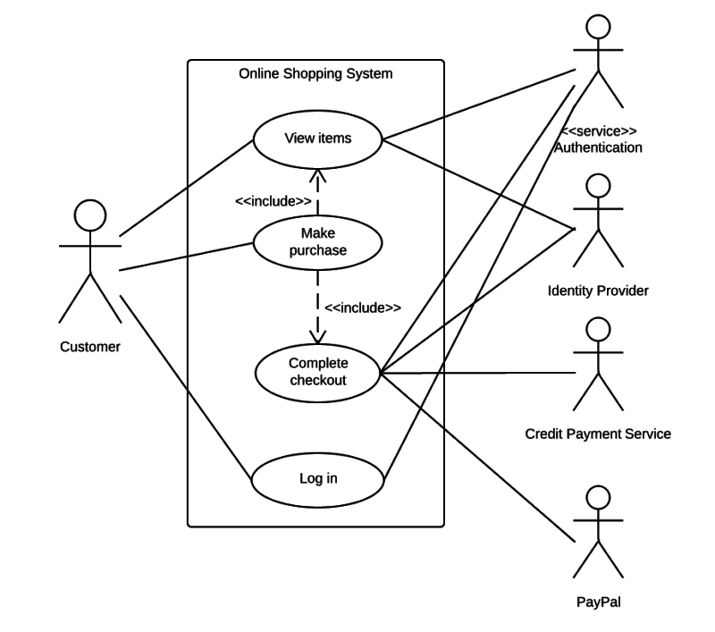

Slide 101
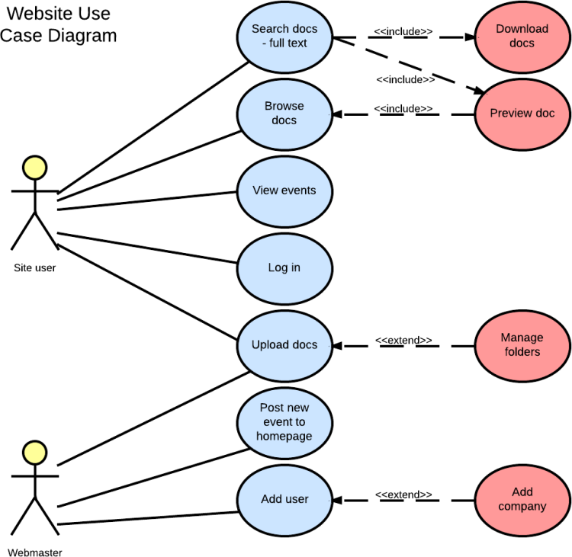

Slide 102
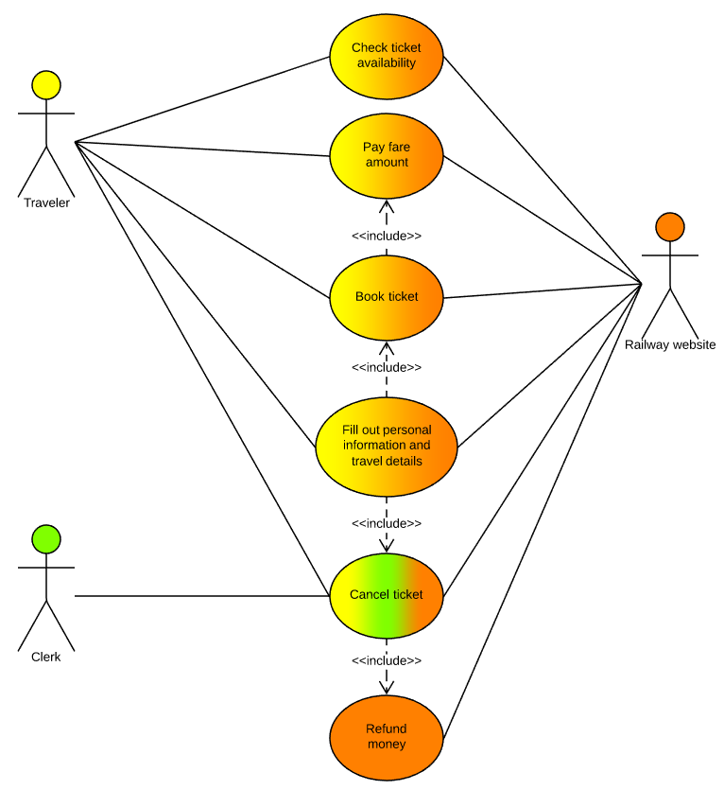
Railway reservation use case diagram example

Slide 103
Overview of UML Diagrams
Behavioral
: behavioral features of a system / business process
Activity
State machine
Use case
Interaction
Structural
: element of spec. irrespective of time
Class
Component
Deployment
Object
Composite structure
Package
Interaction
: emphasize object interaction
Communication(collaberation)
Sequence
Interaction overview
Timing

Slide 104
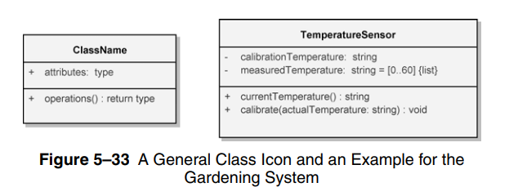
Class Diagram
It is the most common diagram type for software documentation
Class diagrams contain classes with their attributes (data members) and their behaviours (member functions)
Each class has 3 fields:
Class Name
Attributes
Behaviours
The relation between different classes makes up
a class diagram
ClassName
Attributes
Behaviours

Slide 105
Class Attributes
Person
name : String
address : Address
birthdate : Date
ssn : Id
An attribute is a named property of a
class that describes the object being modeled.
In the class diagram, attributes appear in
the second compartment just below the
name-compartment.

Slide 106
Class Attributes (Cont’d)
Person
Attributes are usually listed in the form:
attributeName : Type
Attributes can be:
+ public
# protected
- private
/ derived
+ name : String
# address : Address
# birthdate : Date
/ age : Date
- ssn : Id

Slide 107
Class Attributes (Cont’d)
A derived attribute is one that can be
computed from other attributes, but
doesn’t actually exist. For example,
a Person’s age can be computed from
his birth date. A derived attribute is
designated by a preceding ‘/’ as in:
/ age : Date
Person
name : String
address : Address
birthdate : Date
/ age : Date
ssn : Id

Slide 108
Class Operations
Person
name : String
address : Address
birthdate : Date
ssn : Id
eat
sleep
work
play
Operations describe the class behavior
and appear in the third compartment.

Slide 109
Class Operations (Cont’d)
PhoneBook
newEntry (n : Name, a : Address, p : PhoneNumber, d : Description)
getPhone ( n : Name, a : Address) : PhoneNumber
You can specify an operation by stating its signature: listing the name, type, and default value of all parameters, and, in the case of functions, a return type.

Slide 110
Depicting Classes
When drawing a class, you needn’t show attributes and operation in every diagram.
Person
Person
Person
name : String
birthdate : Date
ssn : Id
Person
name
address
birthdate
Person
eat()
sleep()
work()
play()
eat
play

Slide 111
Class Responsibilities
A class may also include its responsibilities in a class diagram.
A responsibility is a contract or obligation of a class to perform a particular service.
SmokeAlarm
Responsibilities
-- sound alert and notify guard station
when smoke is detected.
-- indicate battery state

Slide 112
Basic components of a class diagram
The standard class diagram is composed of three sections:
Upper section: Contains the name of the class. This section is always required, to know whether it represents the classifier or an object.
Middle section: Contains the attributes of the class. Use this section to describe the qualities of the class. This is only required when describing a specific instance of a class.
Bottom section: Includes class operations (methods). Displayed in list format, each operation takes up its own line. The operations describe how a class interacts with data.

Slide 113
RULES TO BE FOLLOWED:
Class name must be unique to its enclosing namespace.
The class name begins in uppercase and the space between multiple words is omitted.
The first letter of the attribute and operation names is lowercase with subsequent words starting in uppercase and spaces are omitted.
Since the class is the namespace for its attributes and operations an attribute name must be unambiguous in the context of the class.

Slide 114
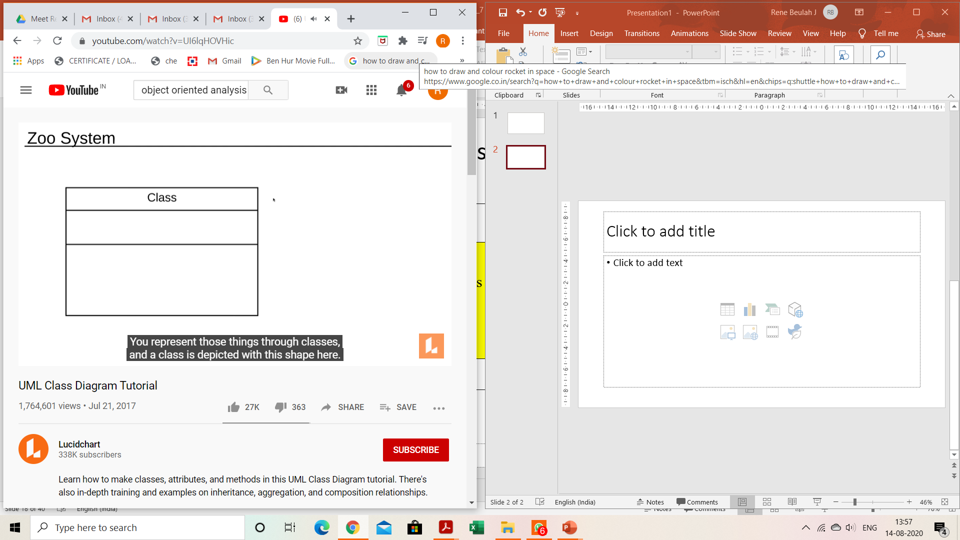
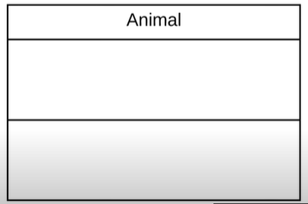
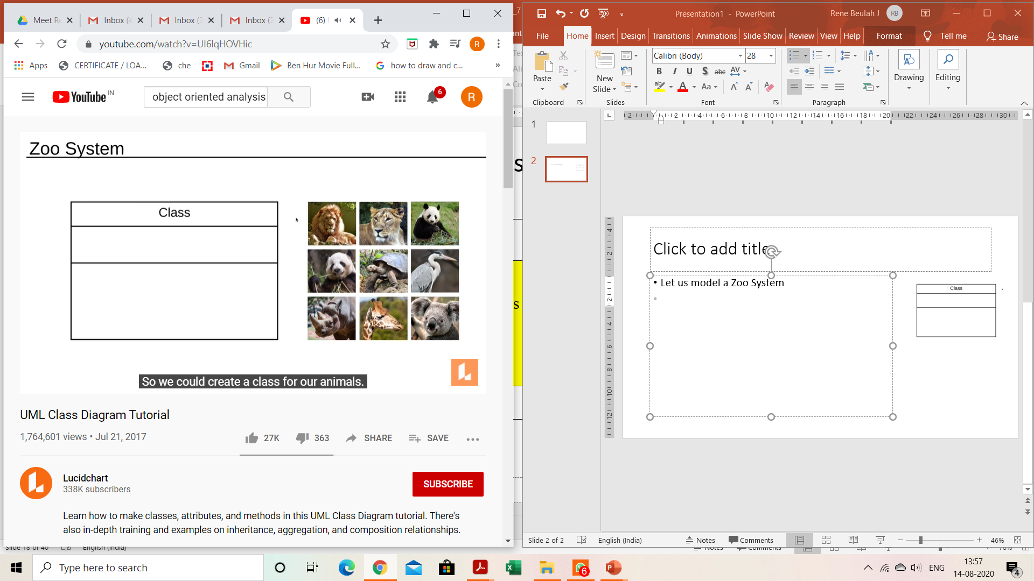
Class Diagram
Basic Components of a Class Diagram
Upper Section
It contains the name of the class
Middle Section
It contains the attributes of the class
Bottom Section
It includes methods
Let us model a Zoo System
What’s in a Zoo? Animals
Let us name the class Animal
If our class is Animal, an instance of that class would be a specific animal

Slide 115
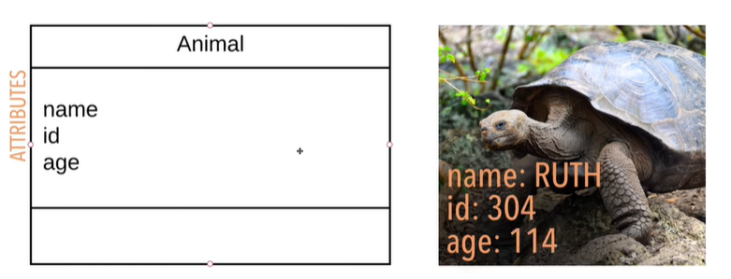
Class Diagram – cont..
Attributes : Second Section
How would you identify each instance of
that class, i.e., a specific animal?
Using Attributes
What are Attributes?
A significant piece of data containing values that describe each instance of that class
They are also known as fields, variables or properties
Format for specifying an attribute:
visibility attributeName : Type [multiplicity] = DefaultValue {property string}
Visibility: It sets the accessibility of an attribute / method
Private (-) Visible only to the elements within the same class
Public (+) Visible to any element that can see the class
Protected (#) Visible to the elements in the class and its sub class
Package (~) Visible to elements within the same package

Slide 116
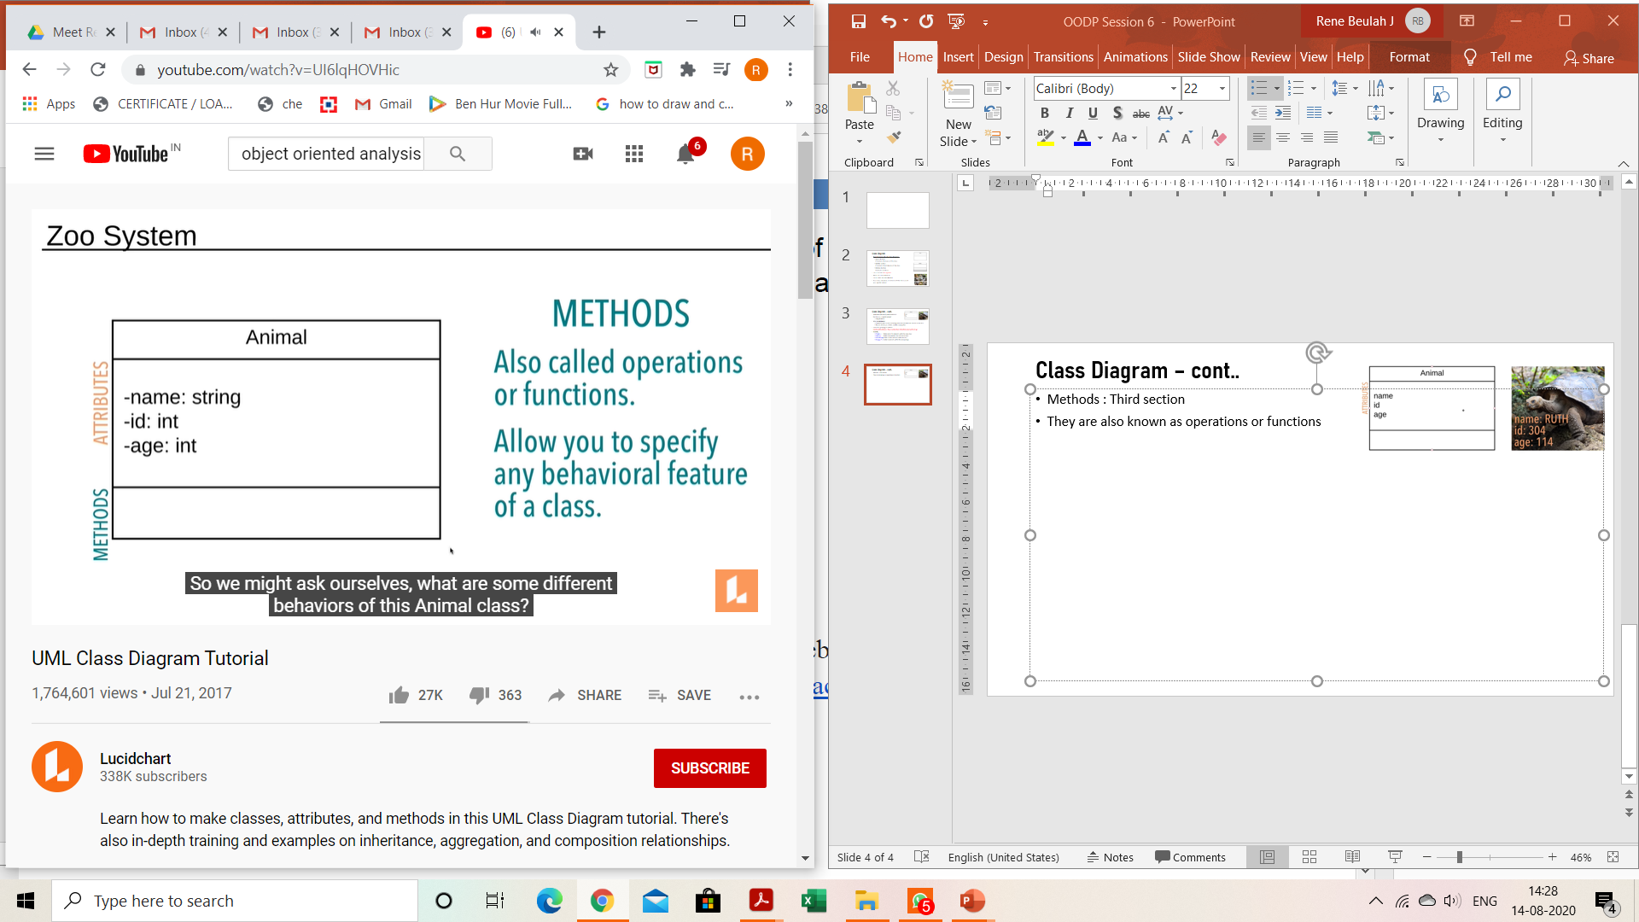
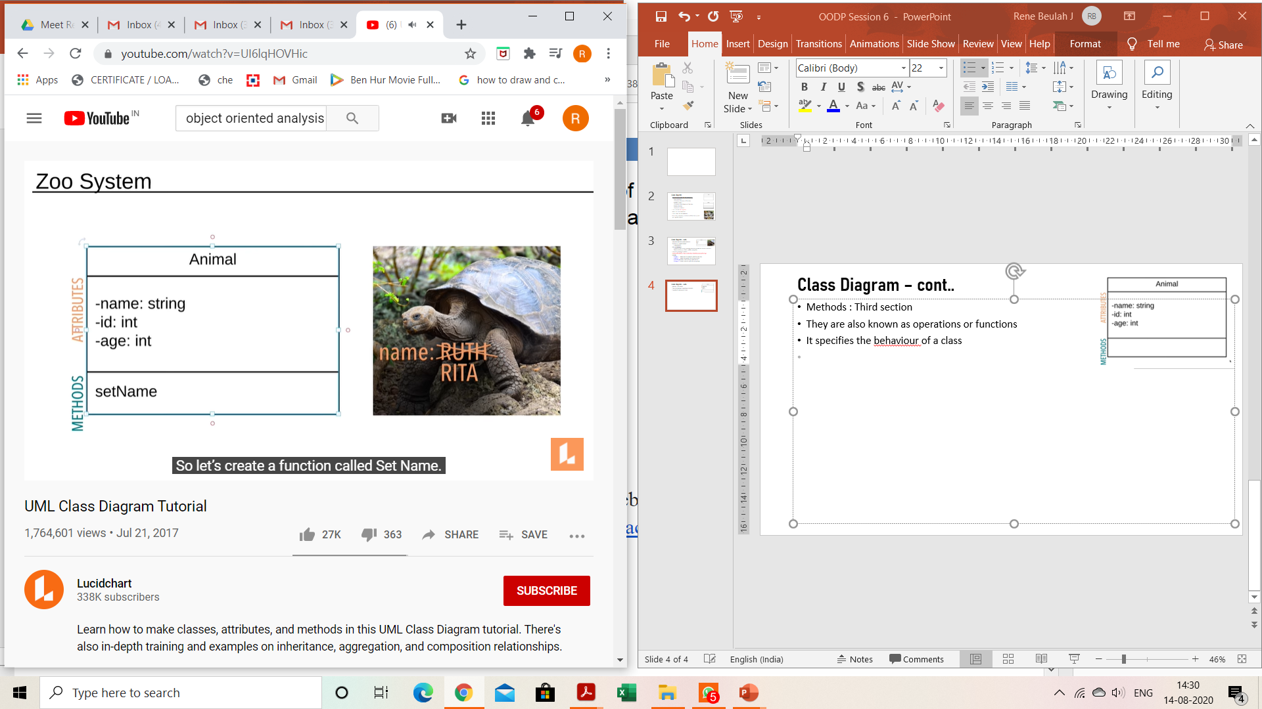
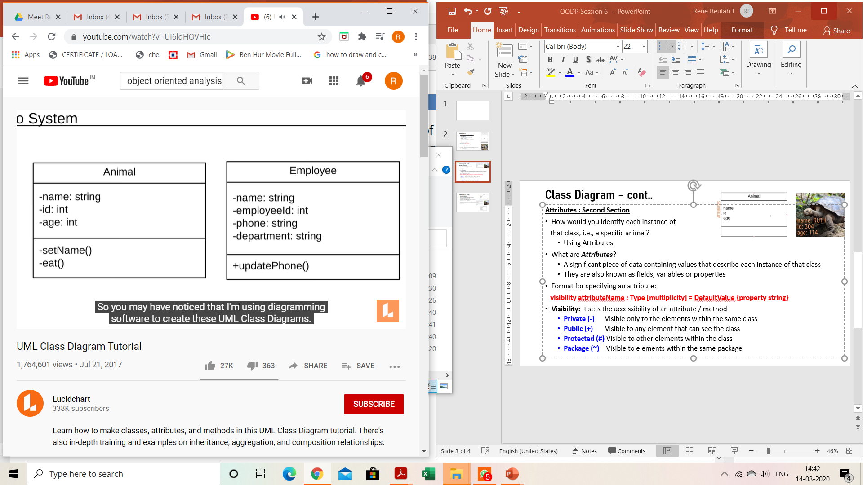
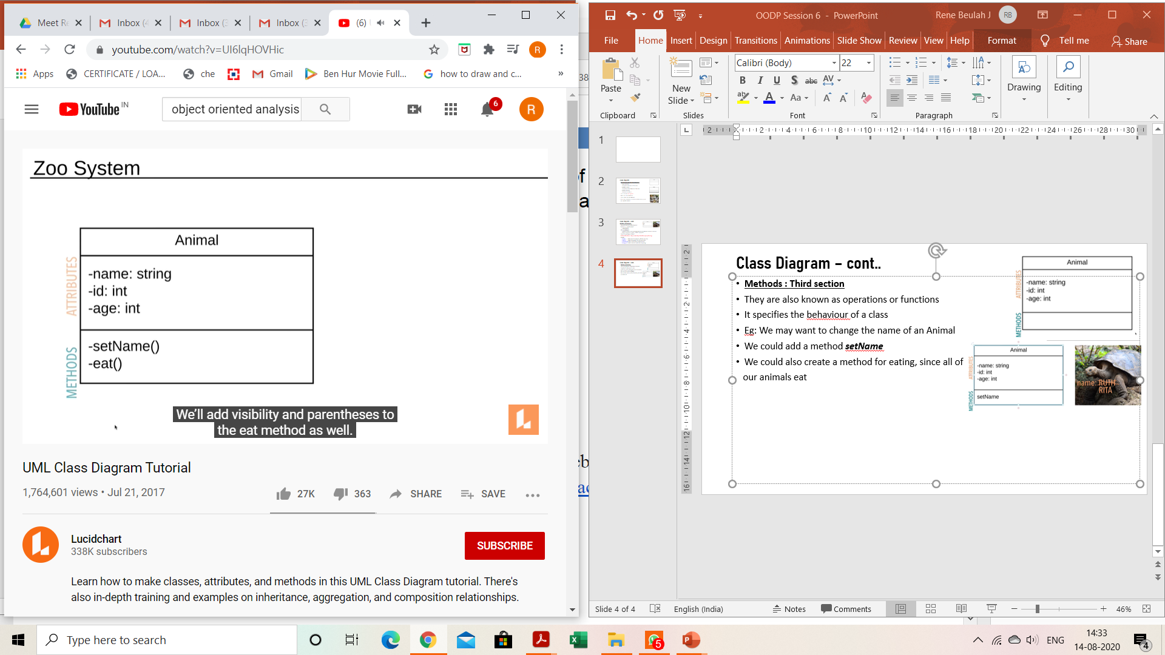
Class Diagram – cont..
Methods : Third section
They are also known as operations or functions
It specifies the behaviour of a class
Eg: We may want to change the name of an Animal
We could add a method setName
We could also create a method for eating, since all of
our animals eat
Lets take another example : Employee Details

Slide 117
Multiplicity and Relationships

Slide 118
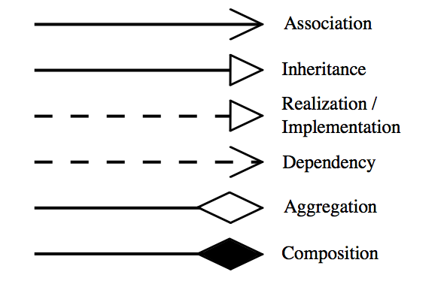
Relationships

Slide 119
Association
An association is a relationship between two separate classes. It joins two entirely separate entities.
There are four different types of association:
Bi-directional
Uni-directional
Aggregation (includes composition aggregation)
Reflexive.
Bi-directional and uni-directional associations are the most common ones.
This can be specified using multiplicity (one to one, one to many, many to many, etc.).
A typical implementation in Java is through the use of an instance field. The relationship can be bi-directional with each class holding a reference to the other.

Slide 120
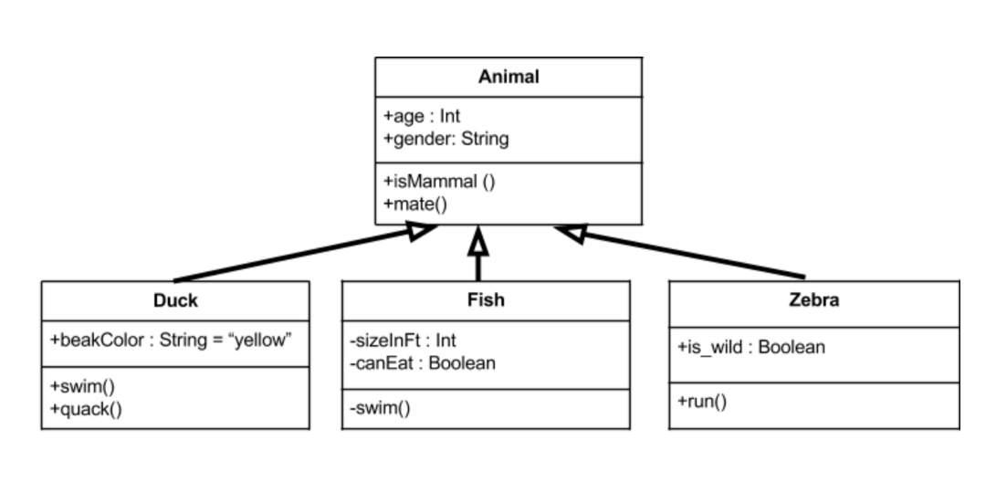
Inheritance
Indicates that child (subclass) is considered to be a specialized form of the parent (super class).
For example consider the following:

Slide 121
Example
Above we have an animal parent class with all public member fields.
You can see the arrows originating from the duck, fish, and zebra child classes which indicate they inherit all the members from the animal class.
Not only that, but they also implement their own unique member fields.
You can see that the duck class has a swim() method as well as a quack() method.

Slide 122
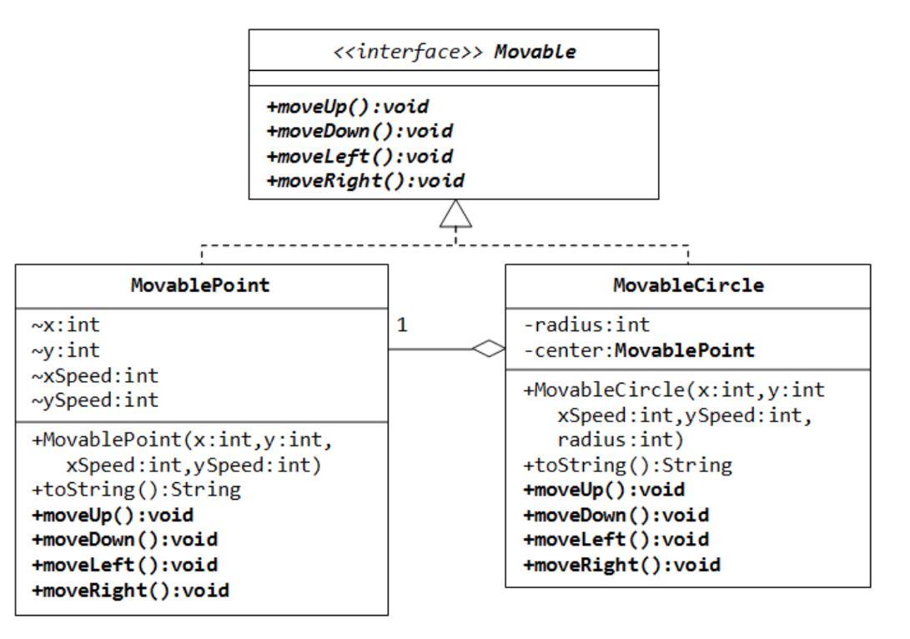
Interface
A relationship between two model elements, in which one model element implements/executes the behavior that the other model element specifies.

Slide 123
Dependency Relationships
Relationships b/w Classes
A dependency indicates a semantic relationship between two or
more elements. The dependency from CourseSchedule to Course exists because Course is used in both the add and remove operations of CourseSchedule.
CourseSchedule
Course
add(c : Course)
remove(c : Course)

Slide 124
Dependency - Aggregation
A special form of association which is a unidirectional (a.k.a one way) relationship between classes.
The best way to understand this relationship is to call it a “has a” or “is part of” relationship.
For example, consider the two classes: Wallet and Money.
A wallet “has” money. But money doesn’t necessarily need to have a wallet so it’s a one directional relationship.

Slide 125
Generalization Relationships
Relationships b/w Classes
Person
A generalization connects a subclass
to its superclass. It denotes an
inheritance of attributes and behavior
from the superclass to the subclass and
indicates a specialization in the subclass
of the more general superclass.
Student

Slide 126
Generalization Relationships (Cont’d)
UML permits a class to inherit from multiple superclasses, although some programming languages (e.g., Java) do not permit multiple inheritance.
Student
Employee
TeachingAssistant

Slide 127
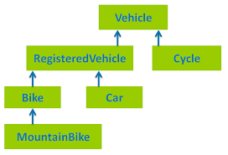
Generalization Relationships (Cont’d)
Multilevel Inheritance

Slide 128
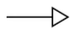
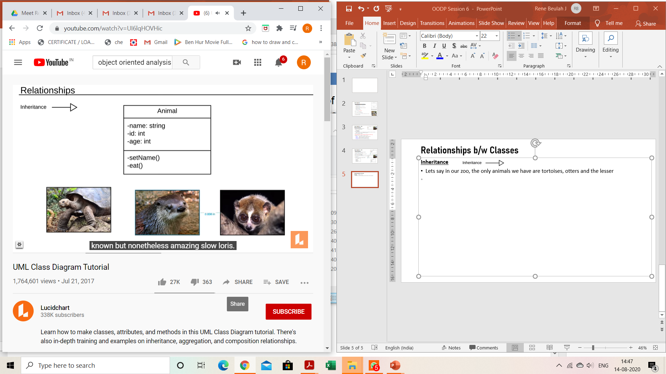
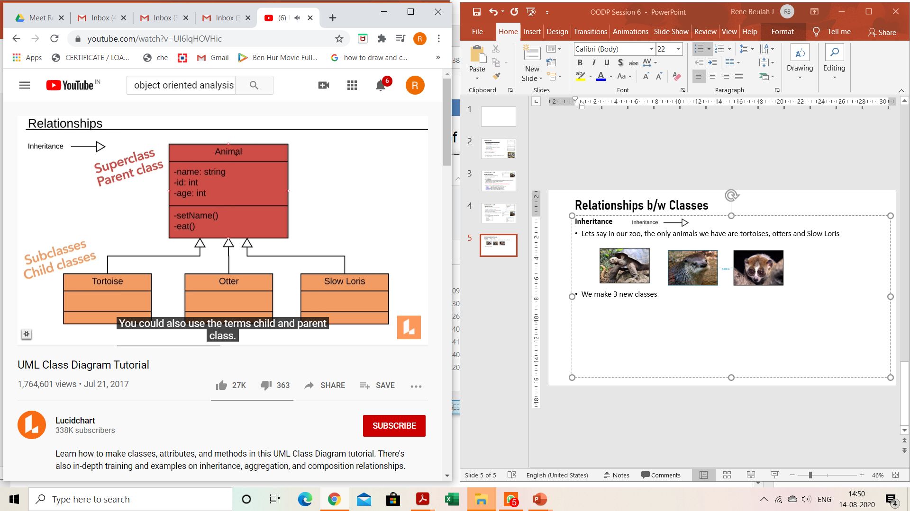
Relationships b/w Classes
Inheritance (Generalization)
Lets say in our zoo, the only animals we have are tortoises, otters and Slow Loris
We make 3 new classes: Tortoise, Otter and
Slow Loris
These subclasses inherit all the attributes and
methods of the superclass
We could add an attribute specific to Otter
in the Otter class
The main advantage of inheritance is that
if we wanted to change or add an attribute
for all animals, we need not make change in
every sub class
We just make the change to the base class ‘Animal’ class and it applies across all sub classes

Slide 129
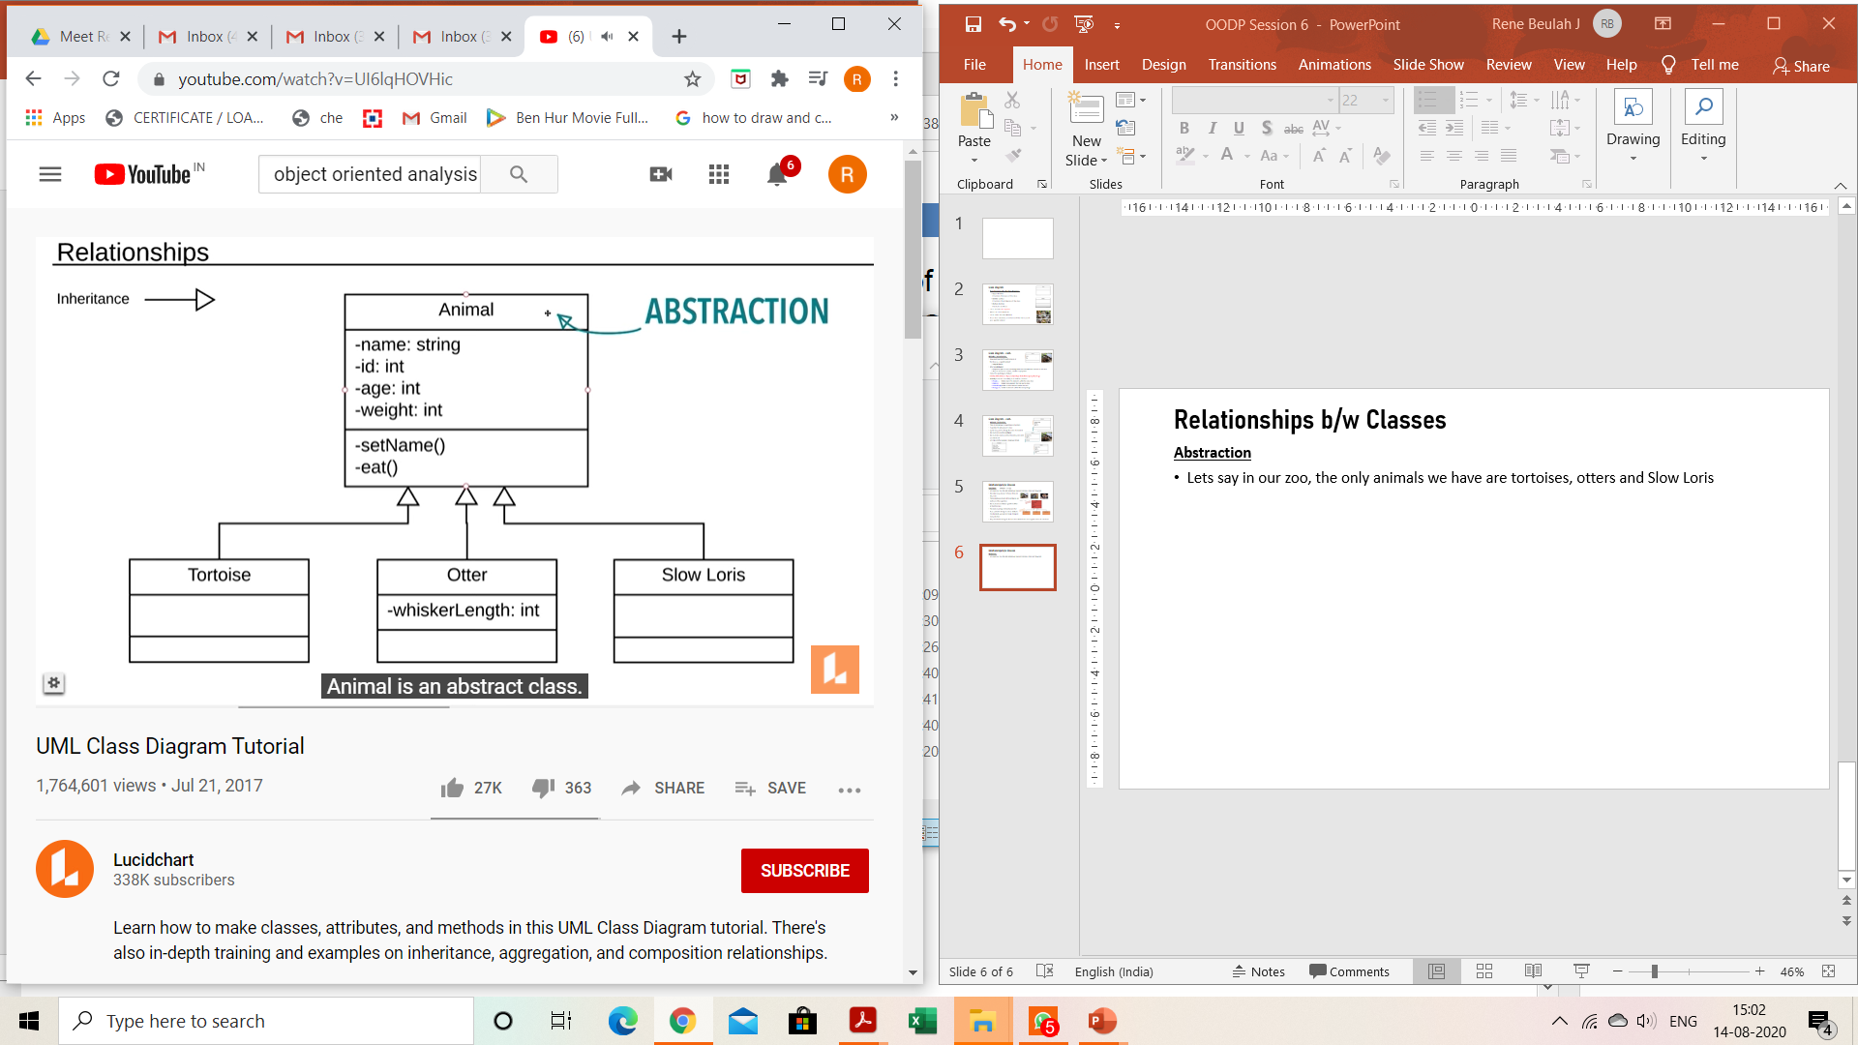
Relationships b/w Classes
Abstraction
In this example ‘Animal’ is the Abstract Class
We will create instance for only the subclasses
We wouldn’t instantiate the Animal class itself
The Animal class is just a way to simplify things and keep the code “dry”
To show that it is an Abstract class, we can write the name of the class in italics Animal or we can enclose it like <<Animal>>

Slide 130
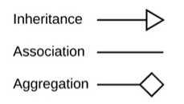
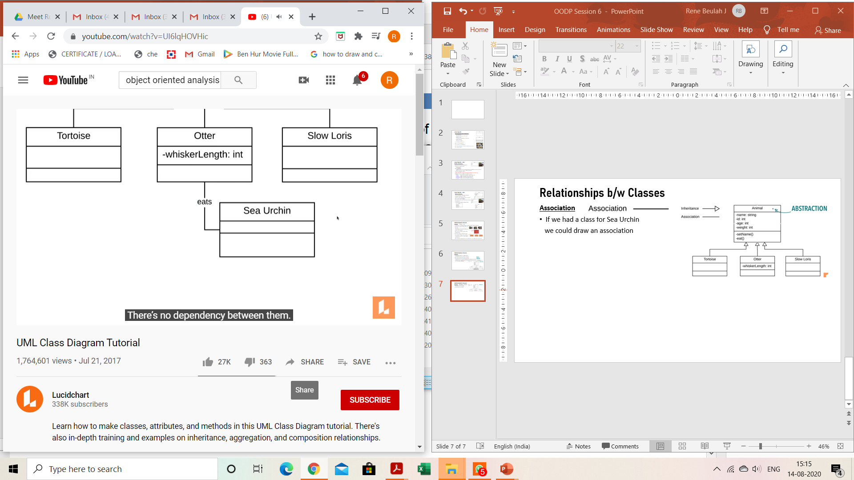
Relationships b/w Classes
Association
If we had a class for Sea Urchin
we could draw an association
Sea otter is a marine mammal in
the north Pacific Ocean
They eat mostly hard-shelled invertebrates
including sea urchins.
ASSOCIATION

Slide 131
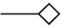
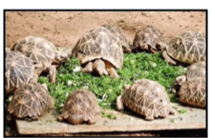
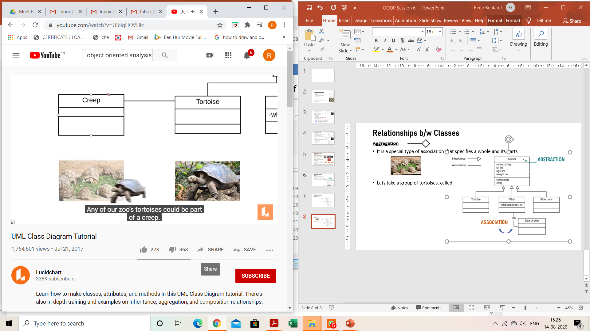
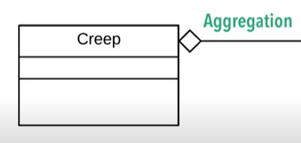
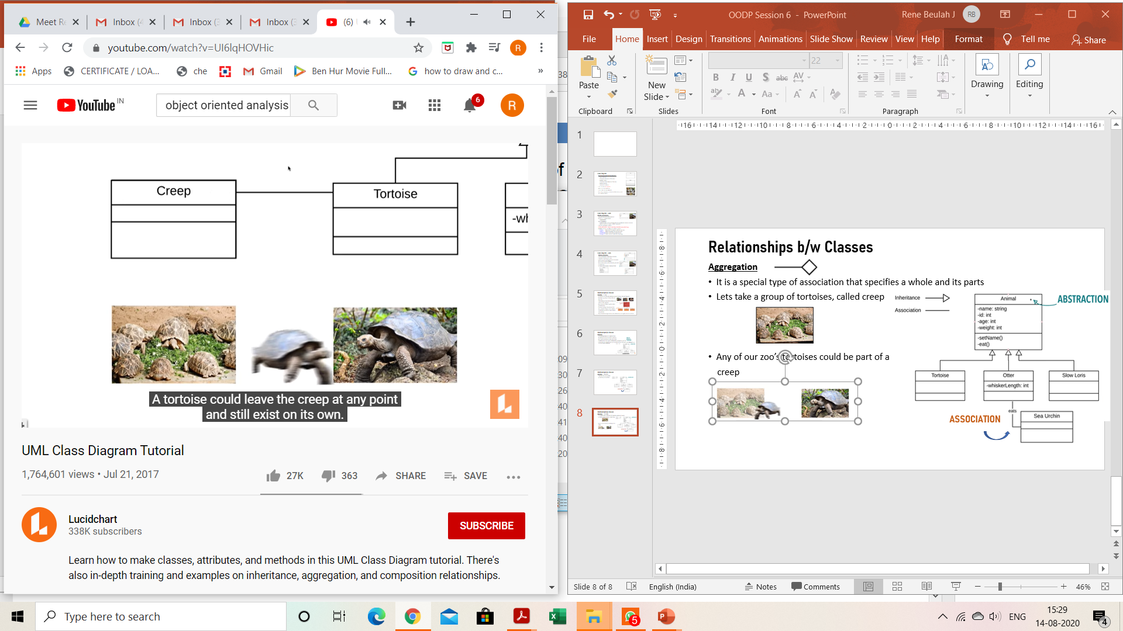
Aggregation ( (open diamond)
It is a special type of association that specifies a whole and its parts, where a part can exist outside the whose
Lets take a group of tortoises, called creep
Any of our zoo’s tortoises could be part of a
creep
A tortoise could leave the creep at any point and still
Exist on its own
ASSOCIATION

Slide 132
An aggregation specifies a whole-part relationship between an aggregate (a whole) and a constituent part, where the part can exist independently from the aggregate. Aggregations are denoted by a hollow-diamond adornment on the association.
Car
Engine
Transmission

Slide 133




Composition
It is a special type of association that specifies a whole and its parts, where the part cannot exist outside the whole
Example: Let us say we have several different visitors centers in our zoo. And each of those visitor centers has a lobby and a bathroom
Now if one of our visitors centers was torn down, the lobby and the bathroom of that visitor center are torn down as well.
Composition : A child object cannot exist without its parent object

Slide 134
A composition indicates a strong ownership and coincident lifetime of parts by the whole (i.e., they live and die as a whole). Compositions are denoted by a filled-diamond adornment on the association.
Window
Scrollbar
1
1
Titlebar
1
1
Menu
1
1 .. *

Slide 135

Composition
A restricted form of Aggregation in which two entities (or you can say classes) are highly dependent on each other.
A human needs a heart to live and a heart needs a human body to function on. In other words when the classes (entities) are dependent on each other and their life span are same (if one dies then another one does too) then it’s a composition.

Slide 136

Multiplicity
After specifying the type of association relationship by connecting the classes, you can also declare the cardinality between the associated entities. For example:
The above UML diagram shows that a house has exactly one kitchen, exactly one bath, at least one bedroom (can have many), exactly one mailbox, and at most one mortgage (zero or one).

Slide 137


Slide 138
Multiplicity Constraints
A multiplicity constraint can be
a single number
a “*”, meaning an arbitrarily large number or simply “many”
a range, denoted by “min..max”
a sequence of single numbers and ranges

Slide 139

Multiplicity
It allows us to set numerical constraints on relationships
Some types of multiplicity are
1 – Just one
n – Specific number
0..* - Zero to many
1..* - One to many (At least one)
0..1 – Zero or one (Optional)
m..n – Specific number range

Slide 140
Multiplicity Constraints
is registered for>
Student
Semester
1..*
0..*
1
takes>
is held during>
0..8
1..*
teaches>
Class Section
Instructor
1..3
0..6
1..*
<works for
is instance of>
1
sponsors>
1
1..*
Department
Course

Slide 141
Questions
From the previous diagram
How many classes can a student take?
Do you have to be registered in any classes to be a student?
Do I need to teach this class to be an Instructor? Do I need to teach ANY classes?

Slide 142


1. What type of core-relationship is represented by the symbol in the figure below?
Aggregation
Dependency
Generalization
Association
Answer: a
2. Which core element of UML is being shown in the figure?
Node
Interface
Class
Component
Answer: d

Slide 143

3. What type of relationship is represented by Shape class and Square ?
Realization
Generalization
Aggregation
Dependency
Answer: b

Slide 144
4. Consider a directed line (->) from the relation ship set advisor to both entity sets instructor and student. This indicates ___________ cardinality.
One to many
One to one
Many to many
Many to one
Answer: b
5. An entity set that does not have sufficient attributes to form a primary key is termed as a ____
Strong entity set
Variant set
Weak entity set
Variable set
Answer: c

Slide 145
Association Relationships (Cont’d)
We can indicate the multiplicity of an association by adding multiplicity adornments to the line denoting the association.
The example indicates that a Student has one or more Instructors:
Student
Instructor
1..*

Slide 146
Association Relationships (Cont’d)
The example indicates that every Instructor has one or more Students:
Student
Instructor
1..*

Slide 147
Association Relationships (Cont’d)
We can also indicate the behavior of an object in an association (i.e., the role of an object) using rolenames.
Student
teaches
learns from
Instructor
1..*
1..*

Slide 148
Association Relationships (Cont’d)
We can also name the association.
Student
membership
Team
1..*
1..*

Slide 149
Association Relationships (Cont’d)
We can specify dual associations.
Student
member of
Team
1..*
1..*
1
president of
1..*

Slide 150
Association Relationships (Cont’d)
Associations can also be objects themselves, called link classes or an association classes.
Registration
modelNumber
serialNumber
warrentyCode
Product
Warranty

Slide 151
Association Relationships (Cont’d)
A class can have a self association.
next
LinkedListNode
previous

Slide 152
Interfaces
An interface is a named set of operations that specifies the behavior of objects without showing their inner structure. It can be rendered in the model by a one- or two-compartment rectangle, with the stereotype <<interface>> above the interface name.
<<interface>>
ControlPanel

Slide 153

A real world Example

Slide 154


A Simple C++ Program with class

Slide 155

Output

Slide 156
18CSC202J - OBJECT ORIENTED DESIGN AND PROGRAMMING Session 8 Topic : Feature Abstraction and Encapsulation, Application of Abstraction and Encapsulation

Slide 157
Abstraction
Data abstraction allows a program to ignore the details of how a data type is represented.
Abstraction (derived from a Latin word abs, meaning away from and trahere, meaning to draw) refers to the act of representing essential features without including the background details or explanations.
C++ classes use the technique of abstraction and are defined as a list of abstract attributes such as width, cost, size etc and functions to operate on these attributes.

Slide 158
Abstraction
While classifying a class, both data members and member functions are expressed in the code. But, while using an object (that is an instance of a class) the built-in data types and the members in the class get ignored which is known as data abstraction.
C++ provides a great level of data abstraction. In C++, we use classes to define our own abstract data types (ADT). Programmers can use the "cout" object of class ostream for data streaming to standard output like this:

Slide 159

Abstraction - Example

Slide 160
What is abstraction
Abstract class in C++ is the one which is not used to create objects.
These type of classes are designed only to treat like a base class (to be inherited by other classes).
It is a designed technique for program development which allows making a base upon which other classes may be built.

Slide 161

Here is an example of declaring Public members of C++ class
#include <iostream>
using namespace std;
class sample {
public:
int gl, g2;
public:
void val()
{ cout << "Enter Two values : "; cin >> gl >> g2;
}
void display()
{
cout << gl << " " << g2;
cout << endl;
} };
int main() {
sample S;
S.val();
S.display();
}

Slide 162

Here is a Private member example in which member data cannot be accessed outside the class
:
#include <iostream>
using namespace std;
class sample {
public:
int gl, g2;
public:
void val()
{ cout << "Enter Two values : "; cin >> gl >> g2;
}
private:
void display()
{ cout << gl << " " << g2;
cout << endl;
}
};
int main()
{
sample S;
S.val();
S.display();
}
If you execute the above program, the private member function will not be accessible and hence the following error message will appear like this in some compiler:

Slide 163
Advantages of Data Abstraction
Class internals get protected from user-level errors
Programmer does not have to write the low-level code
Code duplication is avoided and so programmer does not have to go over again and again fairly common tasks every time to perform similar operation
The main idea of abstraction is code reuse and proper partitioning across classes
For small projects, this may not seem useful but for large projects, it provides conformity and structure as it provides documentation through the abstract class contract
It allows internal implementation details to be changed without affecting the users of the abstraction

Slide 164
Data Encapsulation
Unable to deal with the complexity of an object, human chooses to ignore its non-essential details and concentrate on the details which are essential to our understanding.
Abstraction is "looking for what you want" within an object or class.
But there is another major concept connected to abstraction which is called encapsulation.
So basically, encapsulation can be defined as the process of hiding all of the details of an object that do not throw in or dealt with its essential characteristics.
Encapsulation can also be defined as preventing access to non-essential details of classes or its objects.
Abstraction and encapsulation have close bonding among each other.
Encapsulation assists abstraction by providing a means of suppressing the non-essential details.

Slide 165
ENCAPSULATION
ADVANTAGES
Encapsulated classes reduce complexity.
Help protect our data. A client cannot change an Account's balance if we encapsulate it.
Encapsulated classes are easier to change.

Slide 166

Data Encapsulation
Wrapping of data and functions into a single unit is known as data encapsulation.
Data is not accessible to the outside world, only those functions which are wrapped in the class can access it.

Slide 167
Application of Abstraction
For example, when you send an email to someone you just click send and you get the success message, what actually happens when you click send, how data is transmitted over network to the recipient is hidden from you

Slide 168
Example
The common example of encapsulation is Capsule. In capsule all medicine are encapsulated in side capsule.
Automatic Cola Vending Machine :Suppose you go to an automatic cola vending machine and request for a cola. The machine processes your request and gives the cola.

Slide 169
Examples
Data Abstraction and Encapsulation
Any C++ program where you implement a class with public and private members is an example of data encapsulation and data abstraction
#include <iostream>
using namespace std;
class Adder {
public:
// constructor
Adder(int i = 0) {
total = i;
}
// interface to outside world
void addNum(int number) {
total += number;
}
// interface to outside world
int getTotal() {
return total;
};
private:
// hidden data from outside world
int total;
};

Slide 170
MCQ
1. Wrapping data and its related functionality into a single entity is known as _____________
a) Abstraction
b) Encapsulation
c) Polymorphism
d) Modularity
2. Which concept enables programmers to assign a different meaning or usage to a variable, function, or an object in different contexts?
(a) Inheritance
(b) Message passing
(c) Polymorphism
(d) Abstraction

Slide 171
MCQ
1. Wrapping data and its related functionality into a single entity is known as _____________
a) Abstraction
b) Encapsulation
c) Polymorphism
d) Modularity
2. Which concept enables programmers to assign a different meaning or usage to a variable, function, or an object in different contexts?
(a) Inheritance
(b) Message passing
(c) Polymorphism
(d) Abstraction

Slide 172
Examples
3. Which of the following is the functionality of ‘Data Abstraction’?
a) Reduce Complexity
b) Binds together code and data
c) Parallelism
d) None of the mentioned
4. How will a class protect the code inside it?
a) Using Access specifiers
b) Abstraction
c) Use of Inheritance
d) All of the mentioned

Slide 173
Examples
5. What is the output of this program?
class Test {
int a;
public int b;
private int c;
}
class AcessTest {
public static void main(String args[])
{
Test ob = new Test();
ob.a = 10;
ob.b = 20;
ob.c = 30;
System.out.println(" Output :a, b, and c" + ob.a + " " + ob.b + " " + ob.c);
}
}
a) Compilation error
b) Run time error
c) Output : a, b and c 10 20 30
d) None of the mentioned
Private members of a class cannot be accessed directly. In the above program, the variable c is a private member of class ‘Test’ and can only be accessed through its methods.

Slide 174
ACCESS SPECIFIERS
Session - 11

Slide 175

Access control in classes
One of the main features of object-oriented programming languages such as C++ is
data hiding. Data hiding refers to restricting access to data members of a class. This is to
prevent other functions and classes from tampering with the class data.
Definition :
The access specifiers of C++ allows us to determine which class members are accessible
to other classes and functions, and which are not.
Types of C++ Access Specifiers are:
public : A public member is accessible from anywhere outside the class but within a program.
private : A private member variable or function cannot be accessed, or even viewed from outside the class. Only the class and friend functions can access private members.
protected : A protected member variable or function is very similar to a private member but it provided one additional benefit that they can be accessed in child classes which are called derived classes
•

Slide 176

Syntax of Declaring Access Specifiers in C++
class ClassName
{
private:
// declare private members/methods here
public:
// declare public members/methods here
protected:
// declare protected members/methods here
};
•

Slide 177
Example 1: C++ public Access Specifier
#include <iostream>
using namespace std;
class Sample // define a class
{
public: // public elements
int age;
void displayAge()
{
cout << "Age = " << age << endl;
}
};
int main()
{
Sample obj1; // declare a class object
cout << "Enter your age: ";
// store input in age of the obj1 object
cin >> obj1.age;
obj1.displayAge(); // call class function
return 0;
}
•
Output:
Enter your age: 20
Age = 20

Slide 178
Example 2: C++ private Access Specifier
class Sample
{
private: // private elements
int age;
public: // public elements
void displayAge(int a)
{
age = a;
cout << "Age = " << age << endl;
}
};
int main()
{
int ageInput;
Sample obj1;
cin >> obj1.age; // error
cout << "Enter your age: ";
cin >> ageInput;
obj1.displayAge(ageInput);
return 0;
}
•
Output:
Enter your age: 20
Age = 20

Slide 179
Example 3 : C++ protected Access Specifier
class Sample // declare parent class
{
protected: // protected elements
int age;
};
// declare child class
class SampleChild : public Sample
{
public:
void displayAge(int a)
{
age = a;
cout << "Age = " << age << endl;
}
};
int main()
{
int ageInput;
// declare object of child class
SampleChild child;
cout << "Enter your age: ";
cin >> ageInput;
// call child class function
child.displayAge(ageInput);
return 0;
}
•
Output:
Enter your age: 20
Age = 20

Slide 180






Access Specifiers Example 1
#include <iostream> using namespace std;
class Line
{
public:
double length;
void setLength( double len ); double getLength( void );
};
double Line::getLength(void)
{
return length ;
}
void Line::setLength( double len )
{
length = len;
}
// Main function for the program
int main( )
{
Line line;
// set line length line.setLength(6.0);
cout << "Length of line : " << line.getLength() <<endl;
// set line length without member function
line.length = 10.0; // OK: because length is public cout << "Length of line : " << line.length <<endl; return 0;
}
Length of line : 6 Length of line : 10

Slide 181






Access Specifiers Example 2
#include <iostream>
using namespace std; class Box
{
public:
double length;
void setWidth( double wid ); double getWidth( void );
private:
double width;
};
// Member functions definitions double Box::getWidth(void)
{
return width ;
}
void Box::setWidth( double wid )
{
width = wid;
}
// Main function for the program int main( )
{
Box box;
// set box length without member function box.length = 10.0; // OK: because length is public cout << "Length of box : " << box.length <<endl;
// set box width without member function
// box.width = 10.0; // Error: because width is private box.setWidth(10.0); // Use member function to set it. cout << "Width of box : " << box.getWidth() <<endl;
return 0;
}
Length of box : 10 Width of box : 10

Slide 182




Access Specifiers Example 3
#include <iostream> using namespace std;
class Box
{
protected: double width;
};
class SmallBox:Box
{
public:
void setSmallWidth( double wid ); double getSmallWidth( void );
};
// Member functions of child class double SmallBox::getSmallWidth(void)
{
return width ;
}
void SmallBox::setSmallWidth( double wid )
{
width = wid;
}
// Main function for the program int main( )
{
SmallBox box;
// set box width using member function box.setSmallWidth(5.0);
cout << "Width of box : "<< box.getSmallWidth();
return 0;
}
Width of box : 5

Slide 183
Revision Exercises
Write a C++ program to:
Write a program using public and private class members. Declare a data member c,d as private in a class and use it in the functions (getinput() and showoutput()) derived in public and call the function using object of the class
Write a program using protected access specifier. Use a variable s,t declared in the protected section of the class in the subclass of that class.Use getinput() and showoutput() as functions.
•

Slide 184
Friend function
A friend function of a class is defined outside that class' scope but it has the right to access all private and protected members of the class.
Even though the prototypes for friend functions appear in the class definition, friends are not member functions.
A friend can be a function, function template, or member function, or a class or class template, in which case the entire class and all of its members are friends.

Slide 185
Friend function Example
#include <iostream>
using namespace std;
class XYZ
{
private: int num=100;
char ch='Z’;
public:
friend void disp(XYZ obj);
};
//Global Function
void disp(XYZ obj)
{
cout<<obj.num<<endl;
cout<<obj.ch<<endl;
}
int main()
{
XYZ obj;
disp(obj);
return 0;
}

Slide 186
Inline Function
C++ provides an inline functions to reduce the function call overhead.
Inline function is a function that is expanded in line when it is called.
When the inline function is called whole code of the inline function gets inserted or substituted at the point of inline function call. This substitution is performed by the C++ compiler at compile time.
Inline function may increase efficiency if it is small.

Slide 187

Inline Function - Example

Slide 188
Inline Function - Example
include <iostream>
using namespace std;
inline int Max(int x, int y) {
return (x > y)? x : y;
}
// Main function for the program
int main() {
cout << "Max (20,10): " << Max(20,10) << endl;
cout << "Max (0,200): " << Max(0,200) << endl;
cout << "Max (100,1010): " << Max(100,1010) << endl;
return 0;
}
Output:
Max (20,10): 20
Max (0,200): 200
Max (100,1010): 1010

Slide 189
Session 12
Topic : UML use case Diagram, use case, Scenario, Use case Diagram objects and relations

Slide 190
USECASE DIAGRAM
Use case diagrams give us that capability.
Use case diagrams are used to depict the context of the system to be built and the functionality provided by that system.
They depict who (or what) interacts with the system. They show what the outside world wants the system to do.

Slide 191

NOTATIONS
Actors are entities that interface with the system.
They can be people or other systems.
Actors, which are external to the system they are using, are depicted as stylized stick figures.

Slide 192


Slide 193


Slide 194
Relationship
Two relationships used primarily for organizing use case models are both powerful
«include» relationship
«extend» relationship

Slide 195


Slide 196
«include» relationship
In our hydroponics example, we have an Update Crop Encyclopedia use case.
During analysis, we determine that the Nutritionist actor using that use case will have to see what is in the crop encyclopedia prior to updating it.
This is why the Nutritionist can invoke the View Reports use case.
The same is true for the Gardener actor whenever invoking Maintain StorageTanks.

Slide 197
Neither actor should be executing the use cases blindly. Therefore, the View Report use case is a common functionality that both other use cases need.
This can be depicted on the use case model via an «include» relationship, as shown in Figure.
This diagram states, for example, that the Update Crop Encyclopedia usecase includes the View Reports use case.
This means that View Reports must be executed when Update Crop Encyclopedia is executed.
UpdateCrop Encyclopedia would not be considered complete without View Reports.

Slide 198

«extend» Relationships

Slide 199
While developing your use cases, you may find that certain activities might be performed as part of the use case but are not mandatory for that use case to run successfully.
In our example, as the Gardener actor executes the Manage Garden use case, he or she may want to look at some reports.
This could be done by using the View Reports use case.
However, View Reports is not required when Manage Garden is run. Manage Garden is complete in and of itself. So, we modify the use case diagram to indicate that the View Reports use case extends the Manage Garden use case.

Slide 200

Where an extending use case is executed, it is indicated in the use case specification as an extension point.
The extension point specifies where, in the flow of the including use case, the extending use case is to be executed.

Slide 201


Slide 202
SAMPLE MCQ’S
UML diagram that shows the interaction between users and system, is known as A. Activity diagram B. E-R diagram C. Use case diagram D. Class diagram Answer:C
A UML diagram that facilitates requirements gathering and interacts between system and external users, is called as A. Flowchart diagram B. Sequence diagram C. Use case diagram D. Data flow diagram Answer: C

Slide 203

SAMPLE MCQ’S
3. Which of the following is correct A or B and why

Slide 204

SAMPLE MCQ’S
4. Which of the following is correct A or B and why

Slide 205

SAMPLE MCQ’S
4. Which of the following is correct A or B and why

Slide 206
Session 13 Topic : Constructor and Destructor

Slide 207
Constructor is a special type of member function which is primarily used to initialize the member variables value.
Constructor get automatically invoked when instance or object for the class is created
When a class is instantiated, even if we don’t declare a constructor, compiler automatically creates one for the program. This compiler created constructor is called default constructor.
Rule for defining constructor:
The name of the constructor must be the same as the name of the class.
Constructor don’t have any return type, always of type void.
A Class can have any number of constructor provided properly overloaded.

Slide 208
Features of Constructor
It should be declared in public scope.
It is invoked automatically whenever an object is created.
It doesn't have any return type, not even void. Hence, it can't return values.
It can't be inherited, though a derived class can call the base class constructor.
Constructors should always be non-virtual. They are static functions and in C++ so they cannot be virtual.
A constructor is executed repeatedly whenever the objects of a class are created.
A class can have more than one constructor i.e. constructors can be overloaded.

Slide 209
Syntax for Constructor:
class classname
{
public:
classname([parameter_list])
{
//constructor definition
}
};
Example:
class Student
{
int rno;
public:
Student(int no)
{
rno = no;
}
};

Slide 210
Types of Constructor
Types of Constructors in C++
Constructors are of three types:
Default Constructor - Default constructor is the constructor which doesn't take any argument. It has no parameter.
Parametrized Constructor : These are the constructors with parameter. Using this Constructor you can provide different values to data members of different objects, by passing the appropriate values as argument.
Copy Constructor: These are special type of Constructors which takes an object as argument, and is used to copy values of data members of one object into other object.

Slide 211
Default Constructor:
A constructor that accepts no parameters is called Default Constructor.
Compiler supplies a default constructor if no such constructor is defined.
In this case, default constructor provided by the compiler will be called which will initialize the object data members to default value, that will be 0 or any random integer value in this case.
Example:
class Bank_Account
{
int accno,balance;
public:
Bank_Account()
{
accno =9999;
balance=1000;
}
};
int main()
{
Bank_Account b1;
return 0;
}

Slide 212
Parameterized Constructor:
The Constructors that can take arguments are called parameterized constructor. Sometimes, it may be necessary to initialize the data members of different objects with different values when they are created.
Example:
class Bank_Account
{
int accno,balance;
public:
Bank_Account(int a, int b)
{
accno =a;
balance=b;
}
};
int main()
{
Bank_Account b1(101,10000);
return 0;
}

Slide 213
Example for constructor with parameter
Creating an object of Employee
#include <iostream>
using namespace std;
class Employee {
public:
int id;//data member (also instance variable)
string name;//data member(also instance variable)
float salary;
Employee(int i, string n, float s)
{
id = i;
name = n;
salary = s;
}
void display()
{
cout<<id<<" "<<name<<" "<<salary<<endl;
}
};
int main(void) {
Employee e1 =Employee(101, "Sonoo", 890000); e2=Employee(102, "Nakul", 59000);
e1.display();
e2.display();
return 0;
}

Slide 214
Copy Constructor
Copy constructor is used for creating a new object as a copy of an existing object. It si used when we need to coy data members from one object to another object. It takes reference to an object of the same class as an argument.
Copy constructors are called using the cases below:
Whenever objects of the class are returned by value.
Whenever objects are constructed based on another object that is of the same class.
Whenever objects are passed as parameters.

Slide 215
Copy Constructor
Example:
class integer
{
int a ,b;
public:
// copy constructor declared
integer (integer &v)
{
a=v.a;
b=v.b;
};
};
int main()
{
integer ob1;
integer ob2(ob1);
return 0;
}

Slide 216
Example for copy constructor
#include <iostream>
using namespace std;
class A
{
public:
int x;
A(int a) // parameterized constructor.
{
x=a;
}
A(A &i) // copy constructor
{
x = i.x;
}
};
int main()
{
A a1(20); // Calling the parameterized constructor.
A a2(a1); // Calling the copy constructor.
cout<<a2.x;
return 0;
}

Slide 217
Multiple Constructors
Example:
class Student
{
public:
int rollno;
string name;
// first constructor
Student(int x, string str)
{
rollno = x;
name = str;
}
//second constructor
Student( Student &s1)
{
rollno= s1.rollno;
name=s1.name;
}
void display()
{
cout<<this->rollno<<“ "<<this-> name <<endl;
}
};
int main()
{
Student s1(101,”Abinav”);
Student s2(s1);
return 0;
}

Slide 218
Destructor
Destructor is a special class function which destroys the object as soon as the scope of object ends. The destructor is called automatically by the compiler when the object goes out of scope.
The syntax for destructor is same as that for the constructor, the class name is used for the name of destructor, with a tilde ~ sign as prefix to it.
Syntax:
class classname
{
public ~classname()
{}
};

Slide 219
When does the destructor get called?
A destructor is automatically called when: 1) The program finished execution. 2) When a scope (the { } parenthesis) containing local variable ends. 3) When you call the delete operator.

Slide 220
Features of Destructor
When objects are destroyed, the destructor function is automatically called.
It's not possible to declare it static or const.
There are no arguments for the destructor.
It doesn't even have a void return form.
In the public section of the class, a destructor should be declared.
Destructors cannot be overloaded i.e., there can be only one destructor in a class
They cant be inherited.

Slide 221
Destructors Example:
class A
{
// constructor
A()
{
cout << "Constructor called";
}
// destructor
~A()
{
cout << "Destructor called";
}
};
int main()
{
A obj1; // Constructor Called
int x = 1
if(x)
{
A obj2; // Constructor Called
} // Destructor Called for obj2
} // Destructor called for obj1

Slide 222
Student( Student &s1)
{
rollno= s1.rollno; name=s1.name;
}
void display()
{
cout<<this->rollno<<" "<<this->name<<endl;
}
//destrcutor
~Student()
{
cout<<"destructor invoked"<<endl;
}
};
int main() {
Student s;
Student s1(101,"Abinav");
Student s2(s1);
s.display();
s2.display();
return 0;
}
Example:
#include <iostream>
using namespace std;
class Student
{
public:
int rollno;
string name; //default Constructor
Student() {
rollno=-1; name="";
}
// parametrized constructor Student(int x, string str) {
rollno = x; name = str; }

Slide 223
Methods
A method is a function that is part of the class definition. The methods of a class specify how its objects will respond to any particular message.
A method is a collection of statements that perform some specific task and return the result to the caller. A method can perform some specific task without returning anything.
Methods allow us to reuse the code without retyping the code.
A message is a request, sent to an object, that activates a method (i.e., a member function).

Slide 224
Method Vs Constructor
Used to define particular task for execution
Method can have same name as class name or different name based on the requirement
Explicit call statement required to call a method
There is no default method provided by compiler
Return data type must be declared
Used to initialize the data members
Constructor has same name as the class name
Constructor is automatically called when an object is created
There is always default constructor provide by compiler
Return type is not required in constructor

Slide 225


